Slide 1
2023 Bible Study Overview

Slide 2
Welcome & Introduction
Notes:
Welcome participants
Introduce myself
Thanks for interest in preparing yourselves to explore this year’s Bible study.
We will not have a break for this 2 hour overview, so feel free to get up whenever necessary.
If you don’t want to take notes, I will include my notes on the PowerPoint slides, which will be posted on the presbytery’s website along with a video of the Virtual Bible Study Overview sometime the week after August 21. You just need to view the slides in the “Notes Page” format to see the notes.
And, my goal is to highlight a few things in the study book that I think might help you, but mainly to use my limited time with you to share additional information, ideas and resources.
So, let’s get started in talking about “Sacred Encounters”.

Slide 3
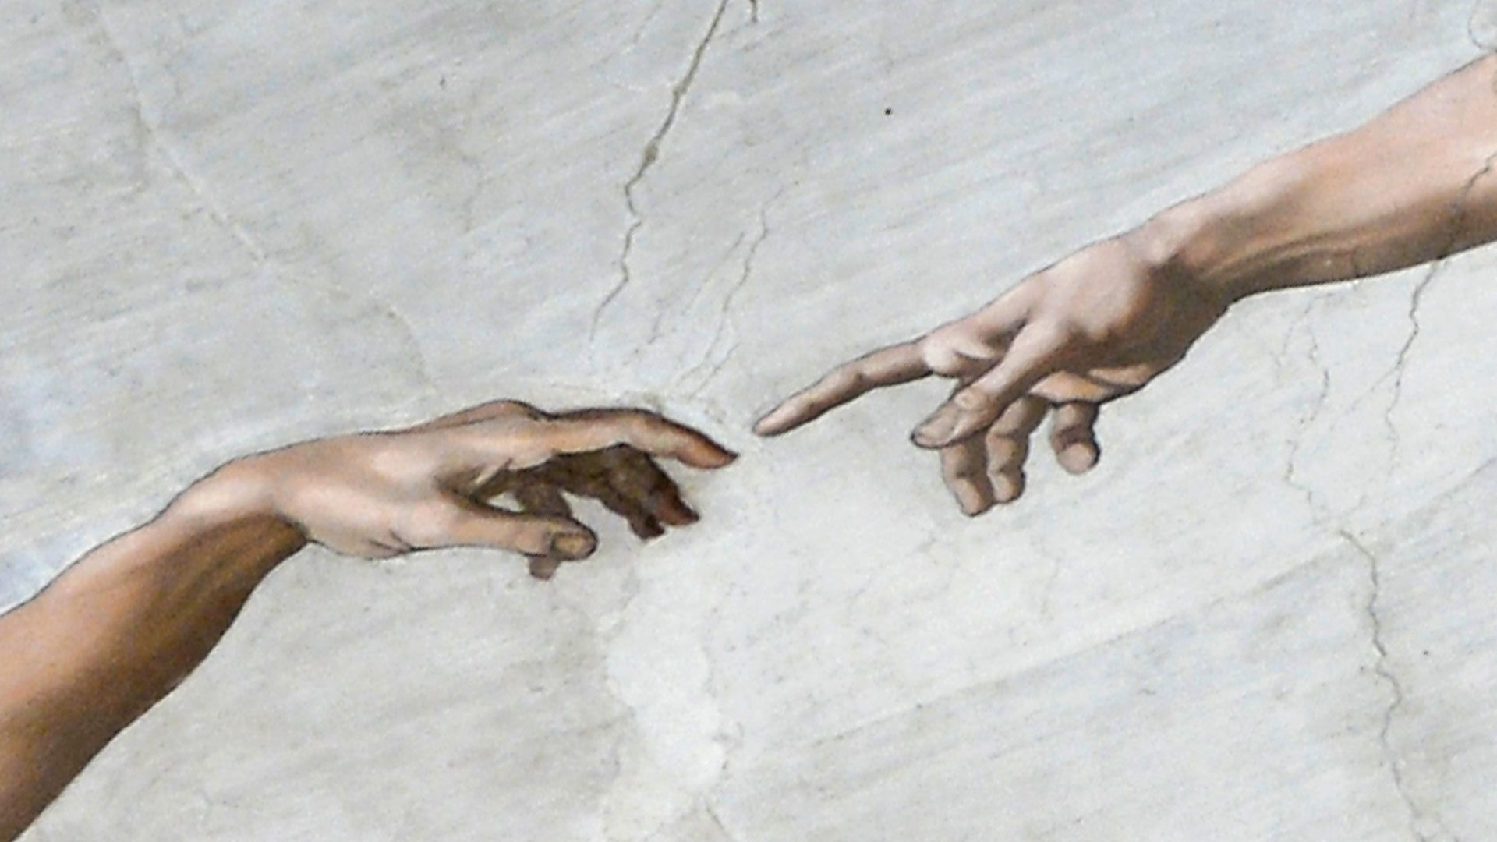
So, what is a sacred encounter?
Notes:
So, what is a sacred encounter?
Sacred means: holy, blessed, revered, hallowed
Encounters are: meetings or happenstances
A “sacred encounter” is what happens when there is a connection made at the heart level and we sense something “more” is taking place at a soul or spirit level.
It is a relational and compassionate meeting with a blessed individual.
The “sacred encounter” of God’s grace came to us here on earth in Jesus Christ.
After that “sacred encounter” with Jesus, those that received the joy and gladness of the good news, the gospel, could then pass a “sacred encounter” to others.
This year’s study includes “sacred encounters” where you can see the hand of God in the story as Jesus and Jesus’ disciples share the Good News with everyday people.
Nowadays, we might call these “God winks”.

Slide 4
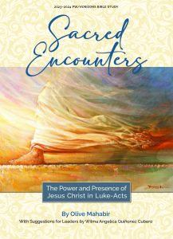
Bible Study Book
$10.00
By Rev. Dr. Olive Mahabir
Suggestions for Leaders by Wilma Angelica Quinonez Cabero
$20.00 for Companion DVD
Each about 10 to 11:30 minutes
Available in digital download
More helpful background information
Notes:
Hopefully, everyone has their study book with them. It’s not absolutely necessary, but it will be helpful to have it as we go through each section.
The price of the regular study book is $10.00, and if you look on the back of the study book, it tells you how you can order it from Horizons Magazine. By the way, if you subscribe to the Horizons Magazine, the study book comes to you free.
This year’s study is written by Rev. Dr. Olive Mahabir (Mah-hah-beer)
Suggestions for Leaders by Wilma Angelica Quinonez (King-o-nez) Cabero
The companion DVD for this study is $20.00.
Each of the videos are about 10:30 minutes and give more background information than what is included in the lessons in the book.
The DVD is also available in a digital downloadable version from Horizons.
The DVD gives much more helpful background information than the book.

Slide 5
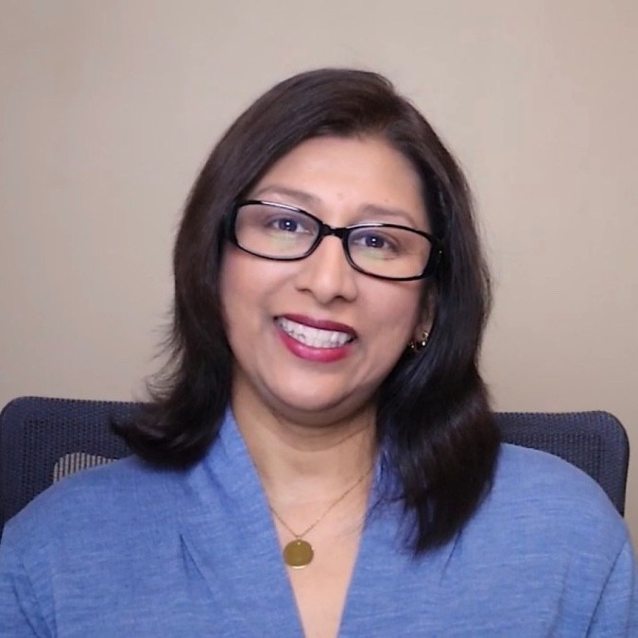
Rev. Dr. Olive Mahabir
Bible Study Author
Born in Trinidad and Tobago
4th generation Presbyterian
In church ministry for 20 years
Currently Assoc. Pastor for Pastoral Care & Adult Spiritual Growth, Northminster Presbyterian, Roswell, GA
Interest in women’s rights & the poor
Notes:
If you turn to p. 2 in your study book, you can read about our author, Rev. Dr. Olive Mahabir (Mah-hah-beer). She is a 4th generation Presbyterian and has been in church ministry for more than 20 years. Currently, she is in Roswell, Georgia. She has an interest in women’s rights and the poor, as we’ll see in our study.

Slide 6
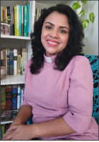
Wilma Angelica Quinonez Cabero
“Suggestions for Leaders” Author
Born in Puerto Rico
Ordained minister of Word & Sacrament
Specialist in ministry with people who are functionally diverse
Also associate professor at the Seminario Evangelico de Puerto Rico
Notes:
Suggestions for Leaders by Wilma Angelica Quinonez (King-o-nez) Cabero
Born in Puerto Rico
Ordained minister of Word & Sacrament
Specialist in ministry with people who are functionally diverse.
Also, associate professor at the Seminario Evangelico de Puerto Rico.

Slide 7
Bible Quiz
How many books are in Bible?
How many books are in OT?
How many books are in NT?
Who wrote most multiple books?
How many epistles are in NT?
Who wrote most words in Bible?
Who wrote most words in NT?
How many books did Luke write?
Notes:
Let’s take a quick Bible quiz. Here are 8 questions to see how you do on some questions about the Bible.
How many books are in the Bible? 66
How many books are in the OT? 39, which covers a little more than 4000 years of history
How many books are in the NT? 27, and those 27 books were written over about a 60-year period
There are multiple authors who wrote multiple books in the Bible. Who wrote the most multiple books? Paul
How many epistles are in the NT? 13
Who wrote the most words in the Bible? Moses with 125,139 words
Who wrote the most words in the NT? Luke with 37,932 words; Paul wrote 32,408 words. That means Luke wrote 27% of the NT, and Paul wrote 23% of it. In fact, Luke is 1 of 5 biblical authors responsible for 45% of the Bible – Moses, Ezra, Luke, Jeremiah and Paul are the 5 authors.
How many books did Luke write? 2
How did you do on this Bible quiz?
We think Paul wrote more of the NT than anyone else since he wrote 13 epistle letters, but it was a Gentile who wasn’t an apostle and never met Jesus that wrote even more of the NT than anyone else.

Slide 8
Who Was Luke
Gentile, Greek physician, investigative journalist, & artist
Paul’s traveling companion & co-worker for years
Only non-Jew NT writer
Based his writings on interviews with eyewitness accounts
Name only mentioned 3 times in Bible, all in Paul’s letters
Notes:
We probably all know that Luke was a gentile and a Greek physician. But Luke was also an investigative journalist and thought to be a skilled artist that painted many of the people he interviewed, including Mary, mother of Jesus.
He was also Paul’s traveling companion and co-worker for years. He accompanied Paul during his 2nd journey from Troas to Philippi and during Paul’s 3rd journey from Philippi to Jerusalem. (Luke will change the pronouns in Acts to say “we” whenever he accompanied Paul.) Finally, Luke accompanied Paul to Rome and stayed beside Paul, day in and day out, for at least two years while Paul was under house arrest.
Luke was the only non-Jew NT writer. Luke’s Gospel is written for people that didn’t know all of the Hebrew terms and history. Therefore, Luke’s Gospel is probably more easily understood by people today, too. For example, Luke often substituted a Greek word for a Jewish word, e.g., the Jewish term rabbi was substituted with the Greek word that means “master.” And, when he traces Jesus’ descent, he goes back to Adam, the ancestor of the entire human race, instead of Abraham, the father of the Jewish nation. Luke seldom quotes the OT , and Luke begins his dating from the reign of the Roman emperor or governor first before getting into Jewish kings or other dignitaries.
Luke didn't assume things either. Probably because of his physician and scientist background, Luke carefully checked things out. Remember, it was probably 30 years after Jesus’ death that Luke wrote his 2 books. But as Luke explains in his opening verses of his Gospel, he based his books on interviews and writings with as many eyewitness accounts as he could. Luke had opportunities to interview the best sources (that is, Jesus' apostles, Mary and Paul), and he listened carefully to their stories and testimonials, taking voluminous notes. Mark and Matthew’s Gospels were already written by the time Luke wrote his Gospel. Because of 2 Timothy 4:11-13, it’s believed Luke met Mark but never met Matthew.
It’s hard to believe, but Luke doesn’t name himself in either of his books. In fact, Luke’s name is only mentioned in the Bible 3 times, all in Paul’s letters: Colossians 4, 2 Timothy 4, and Philemon.

Slide 9
Luke’s Writings
2 books written from 61-63 AD
During time Paul prisoner in Rome
Greek remarkably good
Most complete story teller of gospel of salvation in NT
For Luke, Jesus inclusive leader & Christianity inclusive movement
Over 1/3 material of his Gospel not included in other Gospels
Notes:
Scholars believe Luke wrote his Gospel and the book of Acts around 61-63 AD, but definitely before the destruction of the temple in Jerusalem, since he does not mention it. Therefore, it covers the first 30 years of the early church history.
This would have been during the time Apostle Paul was a prisoner in Rome and, according to 2 Timothy 4:11, Luke was with Paul the entire two years during his first imprisonment.
Luke was a linguist that spoke and wrote classical Greek, but he could also converse and write in Hebrew, Aramaic (Hebrew of Commoners), and Hellenistic Greek (Greek of Commoners). His mastery of the Greek language indicates he was a Greek. The first sentence in Luke has been called the finest example of Greek in the NT.
Faithful Luke believed he had a job to do – to write a history of the early years of the Church founded by the man he had become convinced was the Son of God, Jesus of Nazareth. Luke was thorough and comprehensive, unwavering in his commitment to tell the truth to give us the most complete story of the gospel, the good news, of salvation in the NT.
In Luke’s Gospel, more than any other Gospel, he shows Jesus as an inclusive leader and Christianity as an inclusive movement. In other words, salvation is for everyone. We have different roles in the Church of the Almighty, but we have the same value and worth. Not only does Luke show Jesus spending time with Gentiles and people the world rejects, but he also shows Jesus going to look for them. Jesus wants to spend time with the ostracized, poor, sick, weak, and people deemed “worthless”. Some of those stories we will be reading about in our Bible study this year.
Without Luke’s Gospel we wouldn’t have the stories and parables of: the Good Samaritan, the Lost Sheep, the Lost Coin, the Rich Fool, or the Prodigal Son; the healing of the 10 lepers; Herod putting John the Baptist in jail; healing a man with dropsy; story of Zacchaeus; or the salvation of the thief on the cross. Luke also makes references about women and their stories 45 times in his Gospel. In his Gospel, Luke writes of Elizabeth, Anna, the widow at Nain, Mary Magdalene, Mary and Martha, and the woman who anointed Jesus' feet in the house of Simon the Pharisee. By the way, Luke's perspective on women differs from the common portrayal of women of the time. Luke’s attitude towards women is probably because It’s believed he was a native of Macedonia where women held a more liberated position than anywhere else at the time. Without Acts, we wouldn’t know about the Spirit transforming the disciples, Pentecost, the Church’s birth, the first Christian martyr – Stephen, the conversion of Paul, and the 3 Pauline mission trips.

Slide 10
How are Luke and Acts Linked?
Scroll’s Maximum Length = 32 feet
Luke’s Book = 2 Scroll Lengths
Acts is Continuation of Luke’s Gospel Story
Acts Answers
What Happened Next
Who Was Paul
What Happened to Disciples
How Gospel Got to Rest of Roman Empire
Notes:
The length of Luke’s writings explains why the Gospel of Luke and the book of Acts are separate.
Writings were on scrolls in Luke’s day, and the maximum length of a scroll was about 32 feet. A 3-story building is about 32 feet. A scroll any longer and it was too bulky to carry around.
Luke’s Gospel and the book of Acts have about 2 scrolls’ worth of material, making a physical division necessary. Luke did this by dividing the books into his account of Jesus and his account of the church.
The Gospels tell the story of Jesus’ ministry, death and resurrection. But Luke is the only writer to continue the gospel story after the resurrection. Luke looked at the Bible story as having 3 parts – the OT, the time Jesus was on Earth, and the time of Christ’s Church.
Think about what it would be like reading the NT if we didn’t have Luke’s second volume, the Book of Acts. We would see the ministry of Jesus ending, then read these letters from a man named Paul, who we don’t know used to be Saul, and wonder how the gospel got from Jerusalem or Galilee to Rome and every place in between.
The Book of Acts answers all of our questions about what happened to the disciples, who Paul was, and how the gospel got to all of these places.
Our book tells us that the link between Luke’s 2 volumes is twofold.

Slide 11
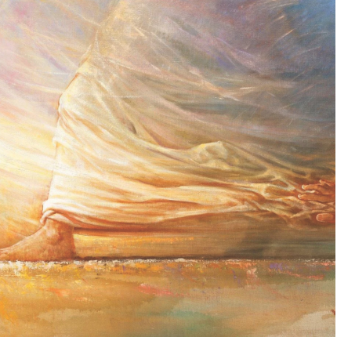
Luke 1:3-4 (CEV)
³ So I made a careful study of everything and then decided to write and tell you exactly what took place. Honorable Theophilus, ⁴ I have done this to let you know the truth about what you have heard.
Acts 1:1-2 (CEV)
1 Theophilus, I first wrote to you about all that Jesus did and taught from the very first ² until he was taken up to heaven. But before he was taken up, he gave orders to the apostles he had chosen with the help of the Holy Spirit.
Notes:
First, let’s look at the prologue to Luke’s Gospel, Luke 1:3-4, and the beginning of Acts, Acts 1:1-2.
Luke and Acts are linked by a common recipient named Theophilus.
Some scholars believe Theophilus is Luke’s wealthy patron who helped support Luke while he wrote his Gospel and the book of Acts. Luke 1:3 refers to him as “most excellent” Theophilus, which is a Roman title of respect used for high governmental officials, somewhat like our addressing a judge as “Your Honor” or a queen as “Your Majesty.”
Other scholars believe the name Theophilus doesn’t refer to any specific person but to all those who would sincerely seek the truth by reading what Luke wrote. The basis of this theory is that the name Theophilus means “one who loves God” or “friend of God”.
Following up on that idea, another theory is that this general meaning could indicate that it was a code name intended to protect a particular person’s identity.
The bottom line is we don’t know.
However, Luke indicates Theophilus had already received Christian instruction and states that Luke’s purpose for writing the Gospel was for Theophilus to “know the truth about what [he] has heard.”

Slide 12
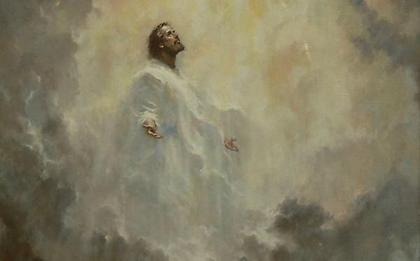
End of Gospel tells about Jesus’ last meeting with disciples then ascending into heaven.
Beginning of Acts gives details about Jesus’ last meeting with disciples before ascending into heaven.
Notes:
Second, Acts is a continuation of Luke’s Gospel story.
Acts continues where the Gospel of Luke’s narrative ends. The end of Luke gives a brief description of Jesus’ last meeting with the disciples and then ascending into heaven, with no details about the ascension. The beginning of Acts gives more details about that last meeting Jesus had with the disciples before ascending into heaven.
Luke is the only writer to continue the gospel story after the resurrection and to include the ascension of Jesus Christ.

Slide 13
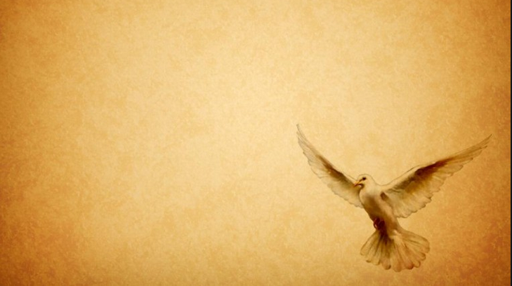
Acts Reveals Holy Spirit of Gospels
Holy Spirit Main Character of Acts
Spirit of God in Gospel becomes Spirit of Jesus or Spirit of the Lord in Acts
Jesus’ Character = Spirit’s Character
Notes:
But, I would like to throw out a 3rd link between Luke and Acts that our author implies but doesn’t spell out in her introduction. The Book of Acts reveals the Holy Spirit, or the Advocate, discussed in the Gospels. In fact, the main character of the Book of Acts is the Holy Spirit. Luke has more to say about the Spirit than any other biblical writer does. In fact, the Holy Spirit is mentioned about 70 times, depending on your translation of the Bible.
The key turning points in Luke’s two-volume story are initiated by the Spirit. In the Gospel of Luke, the Holy Spirit of God is involved in Jesus’ birth, baptism, temptation, and the start of his ministry. The beginning of Acts of the Apostles and the beginning of the ministry to the Gentiles are also marked by experiences of the Spirit.
It’s the story of the Pentecost that signals a change in the Spirit from being called the Spirit of God to the Spirit of Jesus or the Lord. It is Jesus who is pouring out the Spirit of His Church. The Spirit’s character, teachings and acts are Jesus’ character, teachings and acts.
Do you remember at the end of Matthew 28 when Jesus told the disciples that he would always be with them until the end of age? Or in John 14:18-20 when He told the disciples He wouldn’t leave them like orphans and they would know that Jesus was in them. Then, in John 14:26 it tells how the Holy Spirit will teach them and help them to remember everything Jesus taught them.
So, as the story of the disciples begin their ministries and healings, the power and presence of Jesus Christ is within them. Our last 4 lessons of this Bible study are stories from the Acts of the Apostles that are filled with the Spirit of the Lord. The Apostles and their disciples are empowered with the Holy Spirit.
For instance, in Lesson 6, Peter heals the man in the name of Jesus Christ of Nazareth. In Lesson 7, Philip gets a message from the Lord, and the Lord’s Spirit tells him to go over to the eunuch. In Lesson 8 Paul gets a message from the Lord to change his plans and go to Macedonia.
Thus, for Luke, while the resurrection may be the key event in the life of Jesus, the coming and experience of the Spirit is fundamental for the new people of the Lord.

Slide 14
P.2 Information about Authors
Pp. 3-4 Table of Contents
Pp. 5-7 About the Art
P. 8 Things to Look for in the Study
P. 9 Scope and Sequence
P. 84 Annotated Bibliography
P. 87 Future Bible Studies / Schedule
Notes:
So, let’s go through some of the basics of our book.
We talked about the authors earlier, which is on p. 2 of the book.
The Table of Contents is on pp. 3-4
The art in this study is described on pp. 5-7, which is done by various artists. You can find information about the art and artists on pages 5–7 of the book. The art can add an additional dimension to the characters and story in the lesson. As we go through this overview we will look at a few of the images to give you examples of how you might use them in your lessons.
On p. 8 there’s a sections titled “Things to Look for in the Study”. The 1st this listed is “Scope and Sequence”, which is on the next page, p. 9 of the study book.
The “Scope and Sequence” lists the title, scripture and main idea for each of the lessons. You’ll notice there are 5 stories from Luke and 4 stories from Acts. The Scope and Sequence is a good place to start when you’re beginning to schedule individuals who will be leading each of the lessons. I wholeheartedly suggest sharing the duties and not relying on just one leader. One reason I make this suggestion is because the leader will definitely learn more and get more out of the lesson than any of the participants. So share the wealth.
Before we look at the other things in “Things to Look for in the Study”, let’s look at the Annotated Bibliography on p. 84. The bibliography is a list of the books and resources our author used with a brief explanation of the content.
The “Future Bible Studies / Schedule” on p. 87 has a list of the 3 future PW / Horizons Bible studies at the top of the page and a place to list individuals that will be teaching each of the lessons at the bottom of the page.
So, let’s talk about the other items listed under “Things to Look for in the Study” by turning to p. 13 in our books.

Slide 15
Opening Prayer & Closing Prayer
Scripture Passages & Main Idea
Introduction
Contemplate Questions
Examining the Characters
Sacred Encounter
Transformation
Notes from Lesson
Suggestions for Leaders
Notes:
Each lesson includes an opening prayer, like the one on p. 13, and a closing prayer, like the one on p. 17. Feel free to substitute your own prayers for these prayers. I’ll give you some suggestions as we go through the lessons.
Each lesson begins by listing the Scripture and the main idea of the lesson, as it was included in the “Scope and Sequence” on p. 9. Then, on the third page of each lesson is the scripture you can use so everyone is reading the same translation. But, don’t let that deter you from looking at different biblical versions, if you want.
The first section of each lesson, like what is on p. 13, is titled “Introduction” and introduces the context and details of the story.
Turn to p. 15 and you will see a text box in beige color that’s titled “Contemplate”. These are some discussion questions that are an excellent way to review the story and invite participants to talk. Again, don’t feel like you have to use all of them or any of them, and feel free to ask different questions. In addition, the Horizons magazine will have additional questions you can ask, too. We’ll talk more about that at the end of this Overview.
The next section of the lesson, which is “Examine the Characters”, takes a closer look at the primary characters as well as the supporting characters. As we go through this Overview, I will try to include some additional things about some of the characters.
The bottom of the right column on p. 15 is titled “Sacred Encounter”. This section describes the plot of the story, which is the way Luke creates and organizes a chain of events in the narrative. It is the “what” of the text, while the characters are the “who” and the theme, or what is listed as “The Main Idea”, is the “why.”
The last section of each lesson is “Transformative Experience”, like on p. 16. This section asks how is the character changed? How do we identify with the character(s)? How are we changed?
After the Closing Prayer and before the Suggestions for Leaders is a page for you to write down notes. I found this very helpful as I was contemplating what to include in this Overview about each of the lessons.
Finally, on p. 19 we have the “Suggestions for Leaders”. The suggestions are intended to help leaders engage participants in the lesson content. I’ll be sharing additional ideas.

Slide 16
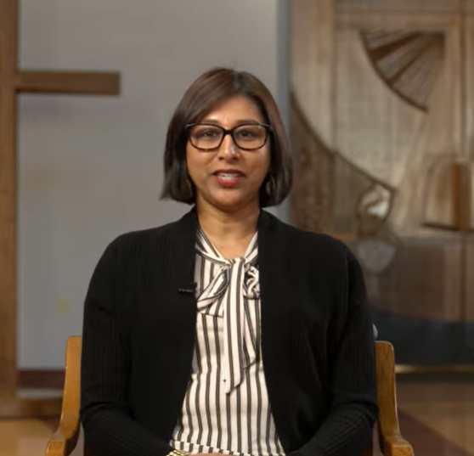
Introduction
Author’s Video Study Intro (9 minutes) www.youtube.com/watch?v=orHnWu72Akg&t=29s
Notes:
As part of the “Workshop for Leaders”, which is a free document that is on the Horizons website, our author included an introduction to the Bible study. This introduction is also included on the DVD. The link for the 9-minute video introducing the Bible study is listed here on the PowerPoint slide.
In my introduction I’ve already covered the information she gives you in the video, plus I added some additional information. Also, the “Introduction” section in the book on pp. 10-11 covers most of the things she covers in the video. If you are meeting online, this video may be an excellent way to introduce your participants to the book.
In addition, I’ve included 3 handouts for your information.
The first is a NT Timeline that also lists the scriptural passages that tell about that event.
The second handout is a list of Miracles of Jesus and where you can read about those miracles in the various Gospels. We’ll be talking about some of the miracles today in our Overview.
The third handout includes some of the scriptures that I’m going to list on the slide but not take the time to read. Therefore, you can read them at your leisure.

Slide 17
Notes:
So, let’s start talking about the lessons.
Remember, Luke plays the part of a reporter, compiling the eyewitness accounts of people who saw, worked and lived with Jesus. Our book tells us how Luke has a special interest in women and how without Luke’s Gospel we wouldn’t know about the miraculous conception of Elizabeth, the mother of John the Baptist, or Mary’s view about the annunciation of the angel, nor her visit to Elizabeth, which is the 1st lesson of our study.
Remember, Joseph is already dead before Jesus begins his ministry, so Luke can’t interview Joseph. Supposedly, John brought Mary with him when he moved from Jerusalem to Ephesus. Maybe that’s when Luke interviewed her, or perhaps he met her when he accompanied Paul to Jerusalem. But, this story is in his Gospel because he probably got it directly from Mary.

Slide 18
Possible Opening Prayer Idea
“Breathe On Me Breath of God”
Video of Story
https://www.youtube.com/watch?v=3WLF3cwXfGc
Longest exchange of 2 women in Bible
Purpose of Elizabeth & Mary meeting?
Confirmation & encouragement
1st testament of Christ’s arrival
Isaiah 40:3, Malachi 3:1, Luke 1:17
Show John filled with Holy Spirit
Notes:
Since the Holy Spirit plays a major part in Acts as well as Luke’s Gospel, you may want to emphasize the presence of the Holy Spirit throughout this story of Mary, Elizabeth, as well as baby John, by using a different Opening Prayer such as singing or reading a verse or two of “Breathe On Me Breath of God”.
1 Breathe on me, Breath of God, fill me with life anew, that I may love the way you love, and do what you would do. 2 Breathe on me, Breath of God, until my heart is pure, until my will is one with yours, to do and to endure.
There is a great video about this story at the link I have listed here - https://www.youtube.com/watch?v=3WLF3cwXfGc – that you may want to use to tell the story, especially if you’re doing the Bible study online.
This conversation between Elizabeth and Mary is the longest exchange of 2 women in the Bible.
What was the main purpose for this meeting of Elizabeth & Mary?
Confirmation and encouragement for Mary that what the angel Gabriel told her was true, but encouragement for Elizabeth, too.
Look at verse 43 or the passage on page 14, when the child in Elizabeth’s womb leaped and Elizabeth said, “Why has this happened to me, that the mother of my Lord comes to me?”, this became the 1st testament of the arrival of Christ, and fulfills what was said in Isaiah 40:3, Malachi 3:1, and Luke 1:17.
To show how John is filled with the Holy Spirit in Elizabeth’s womb, as it says in Luke 1:15.

Slide 19
Visitation Painting on p. 12
Additional Closing Ideas
Popcorn Prayer of thanks for surprises God gives us (shady trees, juicy fruit, great friends)
Modification to p. 19 suggestion
Quiet for 1 minute
Read angel’s words in Luke 1:13: “Do not be afraid… for your prayer has been heard.”
Read Closing Prayer as a group
Notes:
Look at the Visitation painting on p. 12 of our book. What do you see in the image?
What is it that each of the women are holding in their hands?
It’s like they understand that no one but the 2 of them can comprehend what has happened to them and what they will be going through.
Additional Closing Ideas
Do a “Popcorn Prayer” of thanks for all of the wonderful surprises God gives us, like shady trees, juicy fruit, great friends, etc.
Or, do a modification to the suggestion on p. 19. Turn to p. 19. At the bottom of “Examine the Characters” it tells how silence can be a spiritual discipline and opportunity for reflection. Then, under the “Closing Prayer”, it says to be quiet for 1 minute then read the angel’s words in Luke 1:13: “Do not be afraid… for your prayer has been heard.” Then, read the Closing Prayer as a group.

Slide 20
Notes:
If you were making a scary movie and wanted to choose the scariest place you could be at night time, where would you choose?
The 2nd lesson reminds me of an old scary movie. It seems like every scary movie has to have a scene in a cemetery, and it’s even scarier if it’s at night in the cemetery. You wouldn’t realize it if you just read this story in Luke, but the version of this story told in Mark 5 tell you it was night time when Jesus and the disciple got to the country of Gerasenes. Plus, this story took place among the tombs, which would be like our cemetery. So… we have demons at night in a cemetery. How much scarier can you get?
The “tombs” were probably burial places cut out of stones or natural caves in the hills above the Sea of Galilee. Cave “tombs” often had 2 chambers, 1 of which remained empty as long as relatives were still alive. Such “tombs” were often used as shelter by lepers, people believed to be possessed by evil spirit, and the poor. The “tombs” were outside the city, away from the townspeople.
Another theme that we see in this story is a theme of uncleanness or impurity. The story takes place in a Gentile territory (which is considered unclean), and in a tomb (or death) area (which is considered unclean and impure), plus there are pigs involved (which are considered unclean animals).
And, the story that took place right before this story was when the disciples and Jesus were crossing the Sea of Galilee, and Jesus falls asleep in the boat. A terrible storm begins and the disciples believe they are all going to die. They wake up Jesus; Jesus rebukes the wind and the raging waves; everything calms down; and Jesus asks the disciples where is their faith. The disciples then ask each other, “Who is this that commands even the wind and water.”
This story now shows Jesus’ power over demons. Maybe Jesus was trying to teach the disciples that no matter how the powers of evil stacked against Him, Jesus was always in charge. You just have to have faith.

Slide 21
Videos of Story
https://www.bible.com/videos/25169-luke-8-26-39 (3:08)
https://www.youtube.com/watch?v=4TC0pWU4aKI (2:42)
DVD – Exorcism and More Information
Noise Maker to Get Attention
Additional Possible Closings:
Proclaiming Good News – Post-it notes with “God loves you”
Graves Into Gardens https://www.youtube.com/watch?v=KwX1f2gYKZ4 (7:32)
Amazing Grace https://www.youtube.com/watch?v=-hHTb6HRlB4 (3:59)
Notes:
This story can be very hard to visualize if you are reading it. So, if you would like to see the story instead of reading it, I’ve included links to 2 videos. They both have a narrator that reads the Scripture as it is acted out.
If you have a chance, go to the DVD to hear more background information. I especially enjoyed the discussion our author holds on the first half of the DVD about exorcism of evil spirits versus mental health.
Just like Jesus yelled for the legion of evil spirits to get out of the man, you may want to get something that will get the people’s attention in your group, e.g., a bell, a horn, a noise maker, or an air horn. I can see you using something to get the group’s attention in multiple ways.
Additional Possible Closings
Jesus tells the healed man to return to his home and declare how much God has done for you. One way to do that is to write “God loves you” on Post-it Notes and pass out one of the Post-it Notes to each of the participants. Ask them to hand it to someone else over the next 24 hours and proclaim “God loves you”. You can then do a closing prayer as a group. I’ve given each of you a Post-it Note that says “God loves you” on it. I give you the challenge to give it to someone else in the next 24 hours and proclaim “God loves you”.
Graves Into Gardens https://www.youtube.com/watch?v=KwX1f2gYKZ4 (7:32), Brandon Lake live from his album
Amazing Grace https://www.youtube.com/watch?v=-hHTb6HRlB4 (3:59), Leann Rimes

Slide 22
Notes:
Turn to p. 29 in your book. Look at the right column, a little more than 1/3 down the column. Put brackets beginning at “According to Luke, Jesus…” and going through the end of that paragraph.
What this tells you is the story for Lesson 3 of the woman who had been bleeding for 12 years is sandwiched between the story from Lesson 2 and the synagogue official Jairus begging Jesus to come to his house and lay his hands on his dying 12-year-old daughter. And don’t forget about Jesus calming the sea before healing the man in Lesson 2. Jesus had a busy day.

Slide 23
Video https://www.youtube.com/watch?v=kzoLZ5f8BPI (5:56)
Better Explanation on DVD
Story in 3 of 4 Gospels
Focus on picture
A fighter, goal-driven, persistent
Have faith, pray & wait for God’s timing
Fight for what you want
Be intentional & persevere
If you fail, try again
Notes:
I’ve included a link to a video from “The Chosen” series. This one embellishes some, but it shows how Jesus must’ve felt as he always had a crowd of people pushing toward him so He would heal them. It also helps to understand how the woman must have felt being desperate to get to Jesus but knowing she can’t touch anyone.
Also, I thought in the first half of the Lesson 3 DVD video our author gave a great explanation of the woman’s situation in her everyday life and in the community. How hard it must’ve been.
The story of the bleeding woman is included in 3 of the 4 Gospels. There’s a lot to learn from this woman, and that’s probably why Matthew, Mark and Luke have included this story in each of their Gospels.
Plus, Horizons used the picture for this lesson for the cover of the book. That’s another way of knowing this lesson is an important lesson in our study. So, focus on the picture. Notice how the picture shows Jesus walking rather swiftly and the woman barely able to touch Jesus’ robe.
Ask, what do you see in the picture? Do you see the hand in the bottom, right corner reaching for Jesus’ robe? What emotion do you think the woman was feeling?
The woman was a fighter, goal-driven, and persistent. What we see this woman doing may help us as we go through our struggles. We learn it’s sometimes necessary to:
You start by having faith, praying, and sometimes waiting for God’s timing. She trusted in Jesus’ power to heal her.
Fight for what you want – After she exhausted all other avenues, she went against the rules of her time to reach for her healing and blessing.
Be intentional; it makes a difference. Usually, having a goal makes you more intentional. Plus, we saw the woman persevere through the crowd.
If you fail, try again. Past failures can help to lead to success.
On p. 35 of the “Suggestions for Leaders” under “Introduce the Lesson”, it tells how all of these stories in Luke 8 might mean Jesus can heal anything and anyone: the inanimate sea, a person who has no control over the demons in his head, a child who is already dying, and a woman who doesn’t ask for healing but takes what she needs.
What did they all have in common? Faith

Slide 24
https://thefaithspace.com/lessons- from-the-woman-with-the-issue-of-blood/
What can you learn from this woman?
Faith requires risk
True faith arrests God’s attention
God’s attention to your faith is not divided
God works with imperfect faith
When Jesus heals, it is complete
“Who touched me?” means “Who clung to me with their whole being in unwavering faith?”
Devout Jews wore robes w/fringes
Notes:
That idea of faith made me search for some websites that talked about faith. I found a blog written by a 30-something woman that touched me. She calls her site “The Faith Space”.
“The Faith Space” website had an excellent Bible lesson titled “5 Faith lessons from the woman with the issue of blood in the Bible”, so I included the link to their website for information, such as:
What can you learn from this woman?
Faith requires risk
True faith arrests (or captures) God’s attention
God’s attention to your faith is not divided – Jesus was completely focused on the woman.
God works with imperfect faith – the woman had faith and superstition
When Jesus heals, it is complete.
Another thing I got from “The Faith Space” lesson was a great explanation about what Jesus really meant when he asked the question, “Who touched me?” Remember, the woman didn’t actually touch Jesus but just the fringe of his clothing. So apparently, the root word for “touch” is hapto, which means to fasten to or to cling to. So, what Jesus was actually asking was “Who clung to me with their whole being in unwavering faith. (Look at next slide about fringe on Jewish robes.)

Slide 25
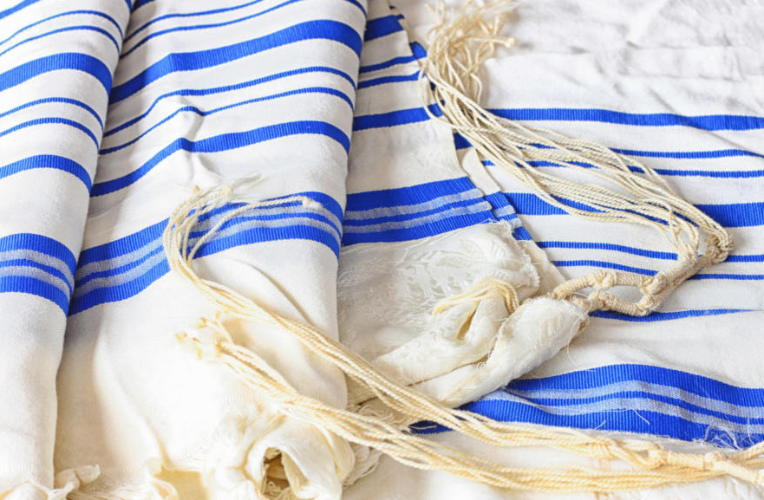
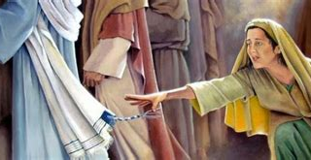
All devout Jews wore robes with fringes
Notes:
I looked up some information about fringes on the Jewish robes. Here’s what I found out.
All devout Jews wore robes with fringes on them. The fringes ended in 4 tassels of white thread with a blue thread woven through them. They were to remind the Jew every time he dressed that he was a man of God and committed to the keeping of God's laws. Later, when it was dangerous to be a Jew, these tassels were worn on the undergarments. Nowadays they still exist on the shawl that the Jew wears round his head and shoulders when he is at prayer. But in the time of Jesus they were worn on the outer garment, and it was one of these tassels the woman touched.

Slide 26
Is #12 important?
What’s biblical meaning of #12?
Means complete or perfect number
Symbolizes God’s power & authority
Closing Prayer Ideas
https://www.womansday.com/life/g27225084/prayers-for-strength/?slide=1
11, 12, 14, 16, 20
Notes:
Remember earlier when I asked you to put brackets around part of the Introduction paragraph on p. 29 of your book? It told how Jesus was on his way to heal Jairus’ terminally ill 12-year-old daughter when the woman who had been bleeding for 12 years touched his robe.
Does it seem interesting to you that the woman’s bleeding began when Jairus’ daughter was born?
This is such a beautiful story, but what is the linkage of the parallel occurrence of “12 years” imply?
Was it a rhetorical device to suggest a link between the two stories?
What’s the biblical meaning of the number 12? The number 12 is considered a complete or perfect number. It symbolizes God’s power and authority.
Closing Prayer Ideas: There are lots of prayer ideas at the website I have listed - https://www.womansday.com/life/g27225084/prayers-for-strength/?slide=1.
It is titled “23 Prayers That Will Give You Strength in Difficult Times”.
I especially liked the prayers on slides 11, 12, 14, 16 and 20.

Slide 27
Notes:
Lesson 4 is about Mary and Martha, who are vastly different people, but their hearts are in the same place.

Slide 28
Story in all 4 Gospels
Women Were Subordinates
Martha Probably Eldest Sibling
Jesus Treated Women Equally
Making Choices Activity
2 things to grab out of burning house
Bag of M&Ms
Whose Choice Right or Wrong?
Notes:
This story is mentioned in all 4 Gospels. That fact alone means there’s something important about this story about Mary and Martha., plus it shows the close relationship they had with Jesus.
A couple of things to remember… In Palestine the place of women was low. In fact, the head of a Jewish household would start their day each morning with this prayer: “Thank you, God, that I am not a Gentile, a woman, or a slave." To the devout Jewish man, all 3 of these groups were suspect, subordinate, and second-class.
Also, it was the culture at this time for the men to sit at the feet of the Rabbi to learn, and it was very unusual for a woman to be invited to do that, too. Women were expected to stay busy grinding grain for bread, then mixing, kneading, and baking it. Then they would also be responsible for drawing water for all the day’s requirements. They would also be busy mending and washing clothes and all the other daily chores that contribute to a thriving family.
Plus, it is believed Martha was the older sibling left in charge of running the household. And, if all 12 disciples and others were traveling with Jesus, fixing the meal would have been a major job. Martha was probably overwhelmed and didn’t want to disappoint her guests. That may be why Luke seems to show Martha in a more favorable light than the other Gospels.
Into that culture enters Jesus who would speak with, teach, heal, and even eat with Gentiles, women, and slaves. Luke and the other Gospel writers probably wanted to show how it was God’s intention to widely and fully accept all into His kingdom.
You may want to start the lesson by asking the participants to go through a few situations where they have to make choices, such as:
You’re awaken by the fire alarm. You have time to grab 2 things as you run out of the burning house. What 2 things would you choose as you’re running out of the house?
Or, you could use a bag of M&Ms for this activity – which could stand for Mary and Martha. Pass around a bowl of M&Ms and ask each person to take only one M&M that’s their favorite color. Eat it. How does it taste? Now, have everyone take one more M&M, but this time they must close their eyes so they can’t see which color of M&M they’re choosing. Eat it. Did it taste different than the first one?
Was your choice right or wrong? Was Mary or Martha’s choice right or wrong or did their choices suit their particular gifts? Both Mary and Martha were serving and worshipping Jesus, but their methods were different. We all make choices of our role in our lives and in our community.

Slide 29
Have Close Relation with Jesus
Videos
https://www.youtube.com/watch?v=yFN1Qc5MuXo (1:29)
https://www.youtube.com/watch?v=hNYlX-ibe4o (0:43)
Meal of Food Jesus Might’ve Eaten
2 Books to Use as Examples
“Three Hens and a Peacock” by Lester L. Laminack
“Don’t Sweat the Small Stuff” by Richard Carlson
Notes:
On p. 40 of our book it tells how Jesus probably wasn’t reprimanding Martha but inviting Martha to sit with Him. Martha was learning from Jesus to seek His presence. In other words, to have a close and intimate relationship with Jesus. That doesn’t mean we aren’t to use our talents to show hospitality to others. But giving Jesus the attention he deserves allows us to serve others.
I’ve listed 2 videos that you could use instead of reading the Scripture. I have a tendency to lean towards the first video, but the second video is animated and very short.
You may want to serve a meal or some items of things like bread, honey, goat milk, goat cheese, grapes, olives, raisins, nuts, pomegranates, figs, fish, yogurt, and other items Jesus might’ve eaten.
There are 2 books I’ve listed that you may want to use as an example or explanation for the Mary and Martha story.
“Three Hens and a Peacock” by Lester L. Laminack This children’s book has a great message about jealousy and understanding others’ role. The 3 hens complain the lazy peacock gets all the attention, and they do all of the work. After attempting to trade roles, they all discover they’re most suited for their particular gifts. It helps us to celebrate the variety of gifts for ministry we all have.
“Don’t Sweat the Small Stuff” by Richard Carlson The actual title is “Don't Sweat the Small Stuff and It's All Small Stuff: Simple Ways to Keep the Little Things from Taking Over Your Life”. The original book was written in 1997 and was on the best-seller list for 2 years. It tells you how to keep from letting the little things in life drive you crazy – kind of like Martha complaining about Mary listening to Jesus instead of helping her prepare the food. It includes lots of simple advice that we know but often don’t follow. It kind of reminded me of reading the Book of Proverbs. One simple advice that fits this story is, “Take time every day to love Jesus and listen to His words.”

Slide 30
Notes:
Lesson 5 is about the healing of the 10 lepers and is the last of the Luke scriptures in our study.

Slide 31
Other Opening Prayer Options
James 1:16-18 (The Message)
1 Thessalonians 5:16-18 (The Message)
Video
https://www.youtube.com/watch?v=WbAt1XTPf58 (1:38)
References to Samaria / Samaritans in Gospels
Concentrated in Luke-Acts & John
Wants us to have effective love for neighbor
Notes:
I want to offer up 2 passages that could be substituted for the Opening Prayer. Both of these passages are listed on your handout.
James 1:16-18 (The Message)
1 Thessalonians 5:16-18 (The Message)
Video - https://www.youtube.com/watch?v=WbAt1XTPf58
This video uses the English Standard Version (ESV) translation for the narration, as does our study book, but it does stop at verse 19, instead of verse 21.
Jesus healed 10 lepers, but only one came back to thank him – a Samaritan. Remember, Samaritans were despised by the Jews.
On p. 47 of our book in the bottom paragraph, it tells how references to Samaria and Samaritans are concentrated in Luke-Acts and John, not Mark and Matthew. I never knew that. The author tells how Luke is showing that Jesus wants us to have effective love for our neighbor. And I never looked at it in quite that way. That’s the great thing about Bible studies in a group – you’re always getting different interpretations and viewpoints.
You may want to show pictures of people with leprosy, which I’m getting ready to do. I will warn you that they are a bit graphic. (See next slide.)

Slide 32
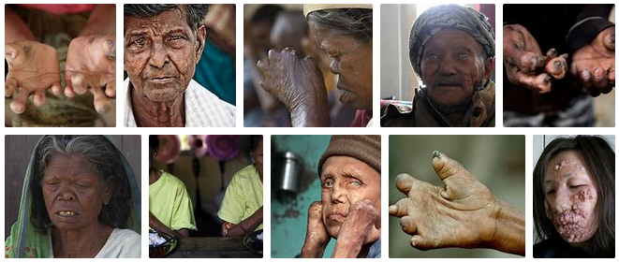
Notes:
Leprosy is likely the oldest infectious disease in human history. It is a horrendous illness that affects the skin, eyes, nose, and peripheral nerves. It is highly contagious, and those who were diagnosed with leprosy were quarantined and isolated from the rest of society.
Jewish law used to require that those with leprosy shout “unclean, unclean” when people approached, to avoid contaminating others. At the time of Jesus, there was no known cure, which left those with leprosy without hope.

Slide 33
What can we learn from this lesson?
God values the least of us
God honors faith
God cherishes gratitude
How can we thank God daily?
Create Gratitude Jar
Set alarm on phone to thank God
Write someone a “thank you”
Closing Prayer
Basket of Blessings & “The Doxology”
Psalm 100:4-5
“Give Thanks With a Grateful Heart”
Notes:
I have listed 3 things I thought of that we have learned from this lesson:
God values the least of us
God honors faith
God cherishes gratitude
To that one leper that came back to thank Jesus, Jesus gave him a 2nd thing – He forgave his sins. From this story we can learn from Jesus that thankfulness is a powerful spiritual exercise with great returns. Jesus was looking at the man’s heart.
The question then is how do we give thanks and keep an attitude of gratitude in our busy everyday lives?
To highlight the importance of gratitude in Jesus’ eye, you may want to brainstorm some ideas with your group on how we can thank God daily. I’ve listed 3 possibilities.
Create a Gratitude Jar where every day you think of at least 3 things throughout your day that you are grateful for. Write down those 3 things on a slip of paper and put it in a jar you have decorated.
Try setting an alarm on your phone to remind you each day to thank God for His gifts.
Write “thank you” cards to someone. It could be people in the congregation or a neighbor or anyone.
Then, I’ve included 3 things that you could do for an alternate closing:
Basket of Blessings - It's easy to get caught up in life and focus too much on negativity. But when we open our eyes to the good things we’ve received in life, we see that God is blessing us daily. Give each participant a small piece of paper and have them write down one way that God has blessed them that day, week, or month. Pass a basket around asking them to share, if they wish, as they drop the slip in the basket. Sharing how God is working and what He has done can be deeply encouraging. Then, recite or sing “The Doxology” for the closing prayer.
Read Psalm 100:4-5 (ESV), which is on the Scripture handout.
Sing or recite the lyrics to “Give Thanks With a Grateful Heart”

Slide 34
Notes:
Do you have a “blemish” or a physical disability?
According to Leviticus 21, no offspring of Moses’ brother, Aaron, which would be the Levites who were the priests, were to come near the altar in the temple if they had a blemish or were disfigured or deformed. From that, the Jews believed that if a person has a “blemish” or a disability it was because of a sin committed by themselves or their parents. Therefore, anyone with a disability was not allowed into the temple to worship God.
So, what was considered a “blemish”? If you were blind or lame, if face is disfigured, if one leg is shorter than the other, if either a foot or a hand is paralyzed, if a hunchback or a dwarf, if an eye or skin is diseased, or crushed testicles (in other words a eunuch).
But during His earthly ministry, Jesus intentionally reached out to those with all kinds of disabilities. The majority of Jesus’ miracles recorded in the Gospels involved people who were sick, blind, mute, deaf, or otherwise suffering a physical disability. Jesus was compassionate with the disabled.
The disciples saw Jesus do most of these healings, but we don’t know if they completely understood what was happening. But just before the story in Lesson 6 we have the extraordinary event of Pentecost happening. The apostles have now received the Holy Spirit. The Holy Spirit has opened their eyes and their hearts even more than before. And as Jesus told them in John 14:26, the Holy Spirit will cause them to remember everything Jesus did.

Slide 35
Do you have a “blemish”?
Beautiful Gate
3 Times for Praying in Temple
Video
https://www.youtube.com/watch?v=AT7cnOkGcBQ (3:21)
Notes:
Lesson 6 shows Peter and John showing compassion when they heal a 40-year-old man who had been lame since birth. Every day the lame man’s friends brought him to the steps going up to the temple to beg for alms. Everyone who came into this gate called Beautiful to the temple would have known this lame man. According to the Jewish historian, Josephus, this gate called Beautiful separated the inner court from the outer “Court of the Gentiles” on the E side. It was supposedly prettier than even the doors covered with silver and gold, which would make it a high traffic area and a good place to beg.
Every day a Jew was required to pray to God. The form of prayer and how many times a day was left up to the individual. Prayer was effective wherever it was offered; but the Jews felt it was doubly precious when offered at the Temple. The Jewish day began at 6am and ended at 6pm. For the devout Jew there were 3 times for people to pray on their own at the temple -- 9am, 12 noon, and 3pm, which would be the 3rd hour, the 6th hour, and the 9th hour.
Peter and John were still living as faithful Jews. Therefore, since they were in Jerusalem, they were going to the temple to the last hour of prayer for that day – the 9th hour or 3pm. But, it seems that Peter and John approached the temple this day with a new mission and purpose.
Video: I really like the video that I have included on this slide for Lesson 6.
It helped me understand where the man was lying on the steps to the temple, and how Peter and John, and all of the other people, had to walk by him every time they went to the temple in Jerusalem.
It showed how Peter got down to the lame man’s level to talk with him.
It showed Peter’s faith in the power of Jesus’ name because he immediately grabs the lame man by his right hand and helps him up. Peter didn’t hope the man would be healed; he knew the man would be healed.
The lame man, too, had faith. He quickly accepted Peter’s hand. He didn’t timidly get up and take a step but walked and leaped. Remember, he had never walked before, but somehow his brain was able to control his muscles to make them move.
But most of all, it helped me understand how totally awesome it was for this man who had never been able to enter the temple before to finally cross that threshold. I remember him looking over to the temple guards to see if they would stop him for being disabled, but they didn’t. How awesome that must have felt. His first move wasn’t to return to his home and give the good news to his family but to jump and leap his way into the house of the Lord.

Slide 36
Importance of This Miracle
Proved message about Jesus was true
Made apostles popular
Helped protect apostles
Helped change hearts & minds about Jesus
People turned to Jesus as their Savior
Principles for Our Spiritual Lives
Establish rhythm of prayer & worship
Love & bless others in beautiful ways
Bring credit & glory to God
Notes:
As we said before, this event probably happened a day or so after Pentecost where 3,000 people became believers in Christ and were baptized. Even though this miracle of healing the lame man happened to only one person, Peter and John’s care for the man in Acts 3 gained the attention of others who were then eager to hear Peter’s gospel message.
A good discussion question to ask your study group might be, “What is the importance of this miracle?” I have listed 5 possible answers on the slide.
The many miracles of healing that Peter and the apostles performed were important because they proved that the apostles’ message about Jesus was true.
They made the apostles popular so people wanted to listen to them.
They helped protect them from the leaders who killed Jesus.
The miracles helped many people to change their hearts and minds about Jesus.
Which made people turned to Jesus as their Savior.
So, you may want to end by asking the ladies in your group what principles they learned from this lesson. I have listed 3 principles that I thought would help increase my spiritual life no matter the circumstance.
To establish a rhythm of prayer and worship, as Peter and John did in verse 1 of Acts 3.
To love and bless others in beautiful ways. We all have gifts and talents that we can share with others. Just like this beggar that was laid at the Beautiful Gate, so there are opportunities to love and bless others in beautiful ways.
To bring credit and glory to God. When we give all of the credit to God, then people see the good gifts, receive them, and gather with us to praise and worship the Lord.

Slide 37
Notes:
Lesson 7 is a story about Philip the Evangelist, not Philip the Apostle, and an Ethiopian Eunuch.
Do you remember what we said at the beginning of Lesson 6 about people who were considered as having a “blemish” and could not enter the temple to worship God?
A eunuch was one of hose considered to have a blemish. So, the Ethiopian eunuch was part of an ostracized group.

Slide 38
Colossians 4:2, 5-6
Have you gone on a pilgrimage?
God-fearer
Leviticus 21:17-21
Map on P. 66 of study book
Notes:
I want to give you another suggestion for an Opening Prayer than the one on p. 61. These verses reminded me of this story of the Ethiopian Eunuch. It is Colossians 4:2; 5-6, which is on your Scriptures handout.
Have you ever gone on a pilgrimage to places like Jerusalem, Mt. Sinai, Vatican City, or another religious spot?
The story of the Ethiopian concerns a religious pilgrimage of a eunuch who felt compelled to make a 750-mile journey to Jerusalem to visit the temple of the God of the Jews. This journey probably took him weeks or months. He was probably what was known as a “God-fearer”, which are Gentiles that believed in and feared or revered the God of the Jews. This Ethiopian would have been granted access to the Court of the Gentiles but would’ve been denied access to the rest of the temple because he was a eunuch. As we discussed in the prior lesson, Levitical law denied the right to give offerings to God to anyone who has a blemish and specifically states eunuchs as being among those specified.
Map: If you look on p. 66 of your book you will see a map that shows the various places discussed in our passage.
The passage talks about an Ethiopian eunuch. Ethiopia during biblical times was also known as Cush. It wasn’t where Ethiopia is now but more where Sudan is located, south of Egypt and along the Nile River. Do you see Cush at the bottom, in the middle of your bigger map?
This Ethiopian was a court official of Candace, the queen of the Ethiopians, in charge of her entire treasury. He would’ve taken a boat up the Nile to the Mediterranean Sea. There he would’ve take another boat over to Gaza. Then, from Gaza he would’ve taken a chariot, which is more like a covered carriage, to Jerusalem, which is about 50 miles. Our story takes place when he was returning home after coming to Jerusalem to worship. His chariot was taking him from Jerusalem to Gaza to get a boat ride home to Ethiopia.
An angel of the Lord tells Philip to leave Samaria “… and go south to the road that goes down from Jerusalem to Gaza,” which was in the wilderness. Look at the black and white inset map. Samaria is 42 miles north of Jerusalem. It’s 50 miles from Jerusalem to Gaza.

Slide 39
Videos
https://www.jesusfilm.org/watch/book-of-acts.html/philip-and-the-ethiopian/english.html (2:44)
https://www.youtube.com/watch?v=XODxQONBp1A (2:24)
Ethiopian reading Isaiah
Eunuchs included in God’s Temple
Verse quoted nearly 40 times in NT
Written 700 years before Jesus
Christianity Ethiopia’s official religion by 4th Century
How would you explain Gospel?
Notes:
I’ve listed 2 video links telling the story of Philip and the Ethiopian. Both use narration from the Acts 8:26-40 passage, although different translations than what is in our book.
The first one is 2:44 minutes. It’s probably the more realistic of what happened.
The second one is 2:24 minutes. It’s made by some youth at Charlotte Chapel in Edinburgh, Scotland for a youth service. I thought they did a great job of converting this story to a present day situation.
We don’t know if the Ethiopian had heard the readings of Isaiah promising inclusion of eunuchs in God’s Temple prior to his visit or while he was in Jerusalem, but he must have purchased a copy of Isaiah while in Jerusalem. The passage for Lesson 7 has the Ethiopian in his chariot reading Isaiah 53:7-8. (By the way, in ancient times, people read aloud, even when reading to themselves. This was slower but allowed for better understanding.)
Now, if this next part isn’t a sacred encounter, I don’t know what is. What else could it have been for Philip to leave Samaria and encounter the Ethiopian in the wilderness just at the point where he was reading a passage that so clearly tells the prophetic vision of the coming of the Messiah. I lose my husband in Walmart, but the angel of the Lord is expecting Philip to find someone somewhere on a 92-mile journey.
The Isaiah 53 passage the Ethiopian is reading is quoted almost 40 times in the NT in explaining about Jesus being the Messiah. Remember, it’s been 700 years between when Isaiah wrote this prophecy and when the events happen to Jesus. So, Philip begins to tell the Ethiopian the good news, and it’s a good bet that Philip included the story of Pentecost and how Peter and the apostles baptized 3000 people that day. That’s probably why the Ethiopian wanted to be baptized.
In this story, the Ethiopian heard the Good News that Jesus came to earth, died for our sins, and raised from the dead and is alive today. Then he immediately accepted the message and was baptized. According to Irenaeus, who was a 2nd century Greek Christian writer, the Ethiopian official returned to his country and shared the Gospel. By the 4th century, Christianity was Ethiopia’s official religion.
If someone asked you what the Good News about Jesus is, could you tell them? The Apostles Creed might be a good guideline for telling someone about the Good News.

Slide 40
Notes:
As our author says in the DVD explanation about Lesson 8, “A study of Acts without a mention of Paul would be an incomplete study.” So, she does include one story about Paul and one of his many converts. This is also the only story in our study where Luke is an eyewitness. If you look at the passage on p. 70 of our book, you will notice that Luke uses the pronoun “we”.
I want to remind you about a few things about Paul and how he went about spreading the Gospel. Paul went on 3 missionary journeys traveling over 10,000 miles. His normal way to begin preaching and teaching when he went into a new town was to go to a synagogue where he knew the people knew about God and God’s promise to send a Messiah. He used that knowledge to help tell his story of how Jesus fulfilled each of those OT predictions about the Messiah. However, a town could only have a synagogue if there were at least 10 male Jews over the age of 13 to start it.
So, on Paul’s 2nd missionary journey, he was in Troas, on the coast of the Aegean Sea. Paul’s original intention was to stay in Asia for his 2nd journey, but God had other plans. God had a “sacred encounter” planned. Paul had a vision of a man in Macedonia asking for help, so that vision made Paul change his plans. They set sail for the small port town of Neapolis and then to the Roman colony of Philippi, which was 8 miles inland.
Paul searched for a synagogue, but there were no synagogues in Philippi. So on the Sabbath, Paul went to one of the 2 rivers that flowed by the town to pray. Paul also thought if there were any Jews in Philippi, that is where he would find them. Think about it, a river is a calm and relaxing place to pray and worship God. But, Paul and his entourage didn’t find any Jews, but they did find a group praying by the river.

Slide 41
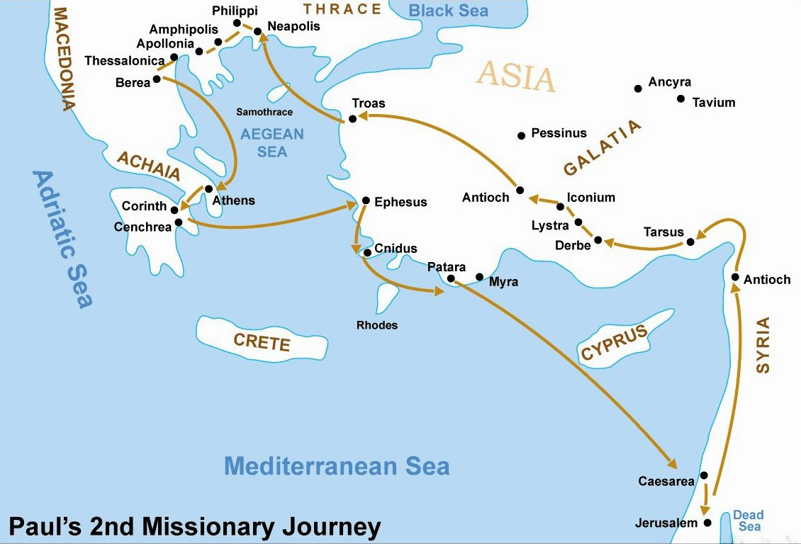
Map Showing Locations
Who was the 1st Christian Convert in Europe?
Lydia was:
Woman of Business
Woman of Faith
Woman of Influence
Mentioned 2 times in Bible
Notes:
I have included a map on the slide to show the locations discussed, such as Troas, Neapolis and Philippi. Philippi was a major commercial Macedonian city that was on the great Roman highway that ran about 535 miles across the Greek peninsula. If a church was founded in Philippi, it would become very instrumental in spreading the Gospel throughout the Roman Empire. This W side of the Aegean Sea was Europe.
Do you know who was the first Gentile convert to Christianity on the European continent? Lydia, the subject of the story in Lesson 8. And the group praying by the river was a group of women, led by Lydia. They seem to have known about God, so they were probably God-fearing Gentiles, like the Ethiopian in our previous lesson.
Lydia was a woman of business. She was originally from Thyatira but was living in Philippi when she met Paul. She was a well-to-do agent or seller of a purple-dye firm in Thyatira, which is SE of Troas, about 40 miles inland. Remember, this purple dye was very expensive and usually reserved for royals or the most wealthy members of society.
Lydia was a woman of faith. When Paul found Lydia and the group of women, they were honoring the Sabbath and worshiping God. When Lydia heard the gospel story of Jesus from Paul, it says God opened her heart. It seems the seeds of faith were already planted in Lydia; Paul watered that faith with the gospel story; and God made them sprout and grow.
Lydia was a woman of influence. Do you remember when we were talking about Luke’s writings at the beginning of our overview and I mentioned that Luke was probably from Macedonia where women held a more liberated position than anywhere else at the time? Philippi was part of Macedonia, which helps to understand how a woman might have owned and managed a business, was wealthy, and held a prominent place in society. Lydia became a charter member of what would become 1 of the most influential churches in the area. Her home in Philippi seems to have been the initial meeting place for this group of believers as well as hosting Paul and his entourage for the duration of their ministry in Philippi.
Lydia is only mentioned 2 times in the Bible, both in Acts 16 telling about her conversion and then later about her baptism. Even though there’s no mention of Lydia in the book of Philippians, read what Paul wrote about a decade later in Philippians 1:3-6, which is on your Scripture handout.

Slide 42
Decorate in Purple
Serve Purple Foods
Discussion on DVD
Background Information
Baptism & the Didache
The story of Lydia in the Bible: Characteristics and lessons we can learn - The Faith Space
Closing Prayer
Joel 2:28-29
Notes:
So let’s talk about ideas you might want to do for this lesson.
Decorate everything in purple. Wear purple clothing. Ask everyone else to wear purple, too. Have purple tablecloths, napkins, plates, utensils, and glasses.
Serve different colors of purple foods like blackberries, purple grapes, cherries, figs, plums, prunes, raisins, pomegranates, blueberry ice cream, blueberry kuchen, grape or blueberry gelatin salad, grape or blackberry or blueberry jelly or preserves, blackberry pie, blueberry swirl cheesecake, blackberry frozen yogurt, grape juice, or creamy berry smoothies.
Olive Mahabir gives lots of background information on the DVD about Paul and Lydia. The topic I enjoyed the most on the DVD was her discussion about baptism and the Didache (DIH-duh-kay), which was written sometime between 65-80 AD and gives specific instructions on how to perform a baptism. These instructions actually are pretty much true today, too.
The Faith Space website that we talked about in Lesson 3 also has some great information about Lydia, so I’ve included a link to that website for your information.
Another possible prayer to use for either the Opening or Closing prayer might be Joel 2:28-29, which is on your Scripture handout, where about 850 years prior to the Day of Pentecost the prophet Joel predicts the outpouring of the Spirit on both men and women.

Slide 43
Notes:
Finally, we have Lesson 9.
To begin this lesson, ask the ladies to team up with a partner. Tell them to look at their partner and think of a description of that person using 10 words or less. Then, when you say, “Ready, Go,” everyone describe your partner at the same time.
You may have known your partner well, but you may not have known that person. So, did you highlight the individual’s personality, their physical features, how they serve God, or what?
Scripture is full of snapshots of characters that were important to the movement of the gospel. Sometimes we get more details than others. In most cases, we find small, discrete discussions that give us glimpses into their lives – kind of like the 10 words or less you gave of your partner.

Slide 44
Tabitha’s Description
From Joppa
Also Known as Dorcas
A “disciple”
“devoted to good works & acts of charity”
Discussion about James 2:24, 26 (ICB)
So you see that a person is made right with God by the things he does. He cannot be made right by faith only… A person’s body that does not have a spirit is dead. It is the same with faith. Faith that does nothing is dead!
Notes:
But, it’s amazing how much we learn about Tabitha in the first verse at the top of p. 78, Acts 9:36.
She’s from Joppa. Joppa is about 35 miles N of Jerusalem. Joppa is believed to be the oldest port city in the world at about 7,000 years old. The port is on the Mediterranean Sea, where many inhabitants and visitors would primarily speak Greek. (Greek of biblical times was like English nowadays – it was the universal language for air, sea and commercial businesses.)
Her name is Tabitha, which tell us she is Jewish, but she is also known as Dorcas (her Greek name). So, why is she known by 2 names? It may be because Tabitha (her Jewish name) or Dorcas (her Greek name) did things for all of the people in Joppa – be they the upper class and wealthy and educated who spoke Greek or her Jewish neighbors who spoke Aramaic.
She’s also described as a disciple. In the NT, Tabitha is the only woman to be called a disciple. Of course, there were other women who were disciples, but for Luke to use this word suggests that she was not only a committed Christian but also an important member of the Christian community at Joppa.
And, she is described as being “devoted to good works and acts of charity”. Luke was saying that Tabitha was not just doing some good works, but she was fanatical to it! Not only that, but aside from good works, she has also done a lot of charitable acts. The story implies that most of Tabitha’s charity works were for widows. Maybe Tabitha was a widow herself; we don’t know. But we do know that Tabitha served God by sewing clothes. Tabitha was probably more than just a seamstress creating one garment at a time. Maybe she got others to make garments, too. Maybe she did more than just feel pity for the predicament of her less fortunate friends and neighbors. We’re only given a glimpse into all of her good works, so we don’t know the details. We do know she did something about it.
You may want to share James 2:24, 26 and discuss the verses meaning in each of their lives.

Slide 45
Do Handwork During Lesson
https://www.instructables.com/No-Sew-Fleece-Blanket-1/
https://www.wikihow.com/Make-a-No-Sew-Blanket
Knit or Crochet Prayer Shawls
Put together Care Packages for Homeless
Videos
https://www.youtube.com/watch?v=QhlRTne06es (2:20)
Opening / Closing Prayer Chain of Knots
Use Our Gifts to Bless Others
Notes:
Handwork: So, why not have ladies bring some of their handwork to do as they listen to the lesson. Or, have some opportunity for people to help do something with their hands as they listen that can be given to a charity afterwards. I have listed links to 2 websites on how to do no-sew fleece blankets. Or, those that wish could knit or crochet prayer shawls or lap blankets for church members facing health challenges. You could also put together care packages for the homeless (with items like canned foods with a pop top, packages of crackers, socks, water bottles, hotel-size shampoos and lotions, and small soaps.)
Video: https://www.youtube.com/watch?v=QhlRTne06es (2:20)
This video is a little different as it draws out the scenes as the passage is spoken. And, it is not word-for-word the Acts 9 passage in our book, but it is close to the same words.
Prayer Chain of Knots: One of the suggestions on p. 83 that I like is to make knots in a piece of yarn, cord or shoelace each time they pray the phrase “Open unto me” while saying the Opening Prayer. Then, during the Closing Prayer, think about all the people who have served the mission of the church. Then, it is our responsibility to be the mentor for those who will come after us on how they are to serve the mission of the church.
Using Our Gifts: In Tabitha’s story, we see the ripple effect of a life lived with faithfulness. Faith in God isn’t just a belief, but a lifestyle. Even though Tabitha’s role is not tremendously active in the story (she is ill or dead for most of it), the way her community mourned her loss demonstrates the impact her life had on those around her. Tabitha used her gifts to bless those who encountered her. We are called to bless others with the gifts we have been given, too.
Peter used his gifts and calling by praying and lifting up a sick sister in the faith. Tabitha used her gifts by clothing the people around her. We may not be the resident seamstress, but God has given each of us gifts that will build up our communities and bless others. So, use your gifts.
Did you notice how each of these “sacred encounters” was more than just a blessed meeting?
It was an encounter that brought HOPE. It also exhibited the participants’ leap of FAITH.
Just as a person jumping out of a plane has hope and faith the parachute will open, that is what knowing Jesus Christ brings to us.

Slide 46
Additional Resources
Horizons
https://www.presbyterianwomen.org/bible-study/sacred-encounters/
Order Study Books – $10
Order Companion DVD – $20
PW Blog https://www.presbyterianwomen.org/category/blog/
YouTube Bible Videos
https://www.youtube.com/watch?v=XIb_dCIxzr0
https://www.youtube.com/watch?v=26z_KhwNdD8
https://www.youtube.com/watch?v=CGbNw855ksw
https://www.youtube.com/watch?v=Z-17KxpjL0Q&t=1s
Today’s Information http://pbyofnewcovenant.org/presbyterian-women/
Notes:
As we are ending this overview, I want to share links to a few more resources you may want to access.
Horizons:
I have included a link to the Horizons website where you can find information for ordering the study books and the companion DVD. Both of these items are available via download, although the study book download is $15, instead of $10. However, the DVD is $20 for the download, too.
The PW Blog is another place to get additional information from the author about each of the lessons. Usually, the author includes additional resources for you to Currently, the blog still has information on it about last year’s study about Sabbath.
YouTube Bible Videos:
I have included links to 4 YouTube videos about Luke and the Book of Acts. Because Luke and Acts are both very long books, it takes 2 videos for each book. These videos are animated overviews of each of these books. It gives some great background information in just a few minutes. Some of the information I shared with you are also included in these videos. The videos are created by The Bible Project group, and they have videos like this for every book in the Bible. I was amazed at how the last minute of part of 2 of the Book of Acts video is basically a summary of our Bible study, “Sacred Encounters”.
Today’s Information:
As I explained at the beginning of this overview, all of my notes are included on the PowerPoint slides. Hopefully, our presbytery’s website will have the PowerPoint slides and the video of the Virtual Bible Study Overview sometime the week after August 21. To view the notes for the PowerPoint slides, you just need to view the slides in the “Notes Page” format.

Slide 47
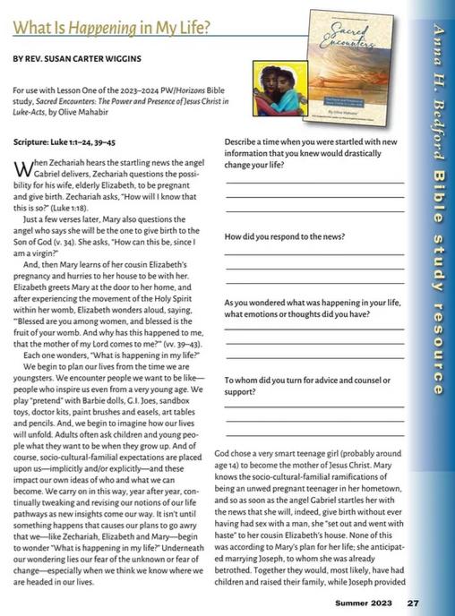
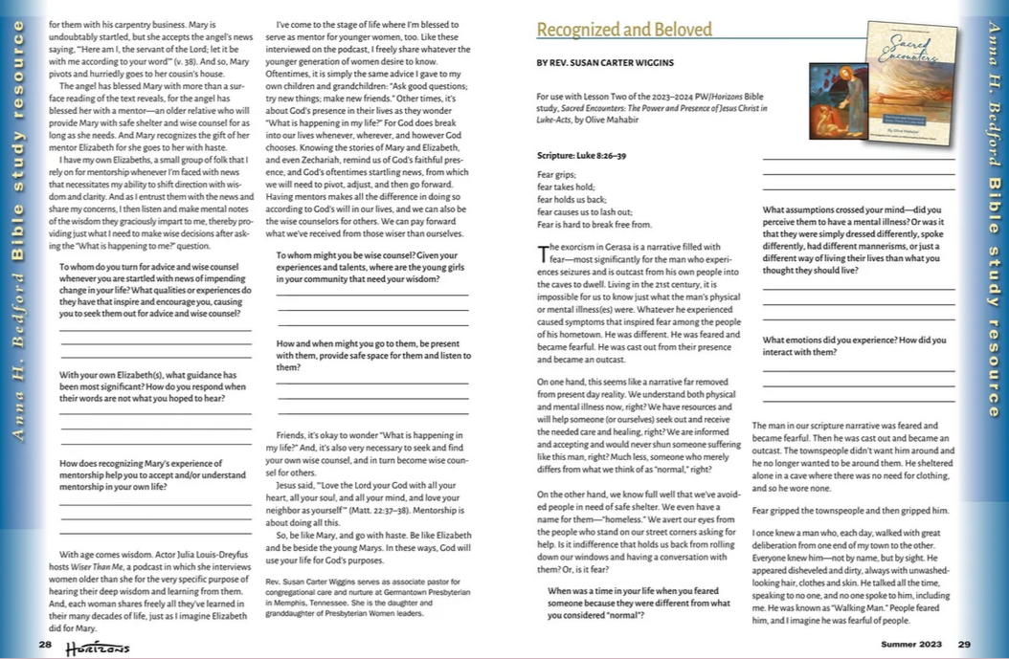
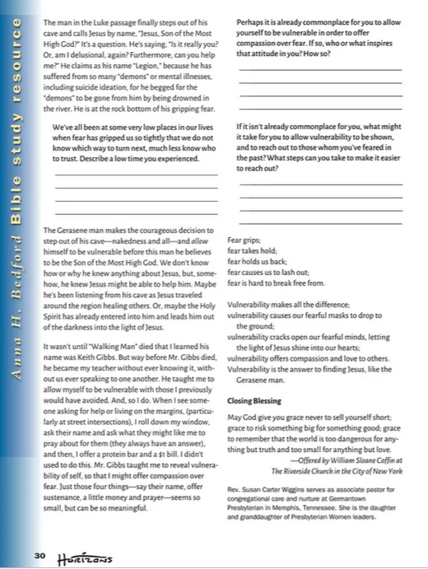
Horizons Magazine
Notes:
Also, you may want to subscribe to the Horizons Magazine to get even more information about each of the lessons for our Bible study.
Near the back of each issue are 2 pages for each lesson of helpful information, questions and hints that you can use for the next 2 upcoming lessons.
FYI… They tell me that the Horizons staff is half what it used to be, and the printers are way behind in getting things out. So, often your printed copies of the Horizons magazine may come late if you are waiting for your mailed copy. However, when they send you the email telling you about what will be in the magazine, you can click on the picture or the box that says “Access Your Digital Version of Horizons Magazine” or where it says “just a click away” and they will all take you to the digital version.
I got my digital version on July 28. I still have not gotten my mailed copy.

Slide 48
Questions

Slide 49
Closing Prayer
Faith makes us sure of what we hope for and gives us proof of what we cannot see. It was their faith that made our ancestors pleasing to God.
But without faith no one can please God. We must believe that God is real and rewards everyone who searches for him. Amen.
Hebrews 11:1-2, 6
Notes:
I would like to end by all of us reading Hebrews 11:1-2, 6.
Thank you.

