Slide 1

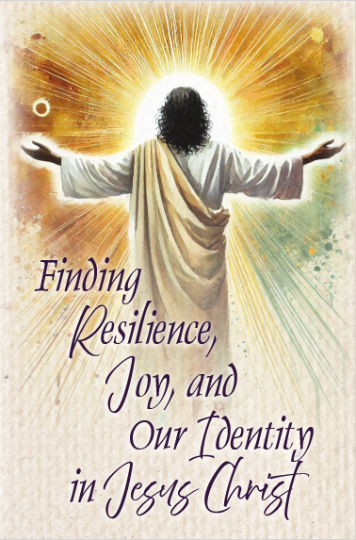
2025
Bible Study Overview
2025–2026
PW/Horizons Bible Study
by Rhashell D. Hunter
Suggestions for Leaders by
Joyce MacKichan Walker

Slide 2
Welcome &
Introduction
Notes:
Welcome participants and thank them for coming to explore this year’s Bible study.
Introduce myself
We will not have a break for this 2-hour overview, so feel free to get up whenever necessary.
If you don’t want to take notes, I will include my notes on the PowerPoint slides, which will be posted on the New Covenant presbytery’s website, then Ministries, then Presbyterian Women sometime the week after August 16. You just need to view the slides in the “Notes Page” format to see the notes.

Slide 3
Bible Study Book
$14.00
Large-print edition - $20
Ecumenical edition - $14
Spanish edition - $14
Audio edition - $15
$20.00 for Companion DVD
2 DVDs, Lesson 1-5, Lessons 6-9
Each about 8 to 13 minutes
Available in digital download
Notes:
Hopefully, everyone has their study book with them. It’s not absolutely necessary, but it will be helpful to have it as we go through each section.
The price of the regular study book is $14.00; but, if you subscribe to the Horizons Magazine, the study book comes to you free. I’ve listed the prices for the other types of editions available.
The companion DVD for this study is $20.00.
There are 2 DVDs with Lessons 1 through 5 on the first one and Lessons 6 through 9 on the second one.
Each of the videos are about 8 to 13 minutes long and give additional information and thoughts.
The DVD is also available in a digital downloadable version from Horizons.

Slide 4
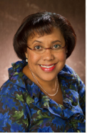
Rev. Dr. Rhashell D. Hunter
Wrote worship materials for “Celebrate the Gifts of Women” for multiple years
Currently teaches Presbyterian Heritage & Polity course at Louisville Seminary
Director of Racial Equity & Women’s Intercultural Ministries for 14 years
Pastor of Community Presbyterian in Flint, Michigan for 9 years
Assoc. Pastor for worship, music & the arts at Fourth Presbyterian of Chicago
Notes:
If you turn to p. 2 in your study book, you can read about our author, Rev. Dr. Rhashell D. Hunter.
Dr. Hunter has written the worship materials for “Celebrate the Gifts of Women” for multiple years.
She served as Director of Racial Equity & Women’s Intercultural Ministries for 14 years, and she currently teaches the Presbyterian polity course at Louisville Seminary.

Slide 5
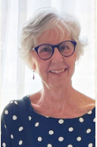
Rev. Joyce MacKichen Walker
1979 graduate of Presbyterian School of Christian Education
Educator/Pastor for 30 years at Nassau Presbyterian Church in Princeton, NJ
Retired in 2018
APCE’s 2008 Educator of the Year
Certified Christian Educator
4th time to write “Suggestions for Leaders” for PW/Horizons Bible study
Notes:
Joyce MacKichan Walker is a retired Certified Christian Educator in the PCUSA and APCE’s 2008 Educator of the Year.
She was ordained as a pastor in 2007 to a role in education and mission at Nassau Presbyterian Church in Princeton NJ, where she served for 30 years, retiring in 2018.
She has written numerous Christian education materials and trains Christian educators.
This is the fourth time to write the “Suggestions for Leaders” for PW/Horizons Bible study, and it shows in the “Suggestions for Leaders” for this Bible study. I think you will find that Joyce has some very good ideas on how to present each of the lessons.
If you would like to follow the lessons as written in the study book, both of these ladies have done a good job of giving you lesson plans and supplying many, many resources to assist you. Just follow the “Suggestions for Leaders” at the end of each of the chapters.

Slide 6
Additional Resources
Horizons
  https://www.presbyterianwomen.org/bible-study/resilience/
  PW Blog – Lessons 1 & 2 are posted https://www.presbyterianwomen.org/category/blog/
  Subscribe to Horizons’ to get “Anna H. Bedford Bible Study Resource” beginning Summer 2025
Today’s Information – http://pbyofnewcovenant.org/presbyterian-women/
(View slides in “Notes Page” format)
pbyofnewcovenant.org >> Ministries >> Presbyterian Women
Notes:
Today, I will be highlighting a few things in the study but also providing some additional ideas, information and explanations that may be helpful to you.
In addition, I want to share links to a few more resources that Horizons has given you.
Horizons:
This first link is to the Horizons website where you can find information for ordering the study books and the companion DVD.
The PW Blog is another place to get additional information from the author about each of the lessons. Currently, the blog has information for the Introduction and Lesson 1 as well as Lesson 2. The information seems to be similar to what is included on the DVD.
Also, in the Horizons magazine, there are 2 pages of additional insights and questions to accompany each of the lessons. By the way, an electronic version of the magazine is sent to you earlier than the “hard copy” magazine.
Today’s Information:
As I explained at the beginning, all of my notes are included on the PowerPoint slides. Hopefully, the PowerPoint slides will be posted on the presbytery’s website a few days after the August 16th Zoom overview. To view the notes for the PowerPoint slides, you just need to view the slides in the “Notes Page” format.

Slide 7
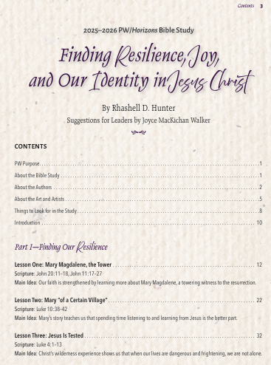
Table of Contents
Notes:
So, let’s quickly go through some of the basics of what is included in our study book. If you have your study books, you may want to turn through the pages as we talk about each item.
We talked about the authors earlier, which is on p. 2 of the book.
The Table of Contents is on pp. 3-4. You will see that the lessons are broken into 3 parts.
The first part is “Finding Our Resilience” and shows the resilience of Mary Magdalene, Mary of a Certain Village, and Jesus.
The second part is “Finding Our Joy” and the stories showing joy are the prodigal child, the widow’s offering, and what Christians are to do.
The third part is “Finding Our Identity” and the stories of the woman who was bent over, Jesus’ baptism, and the travelers on the road to Emmaus.
The art and the artists in this study are described on pp. 5-7.
On p. 8 there’s a section titled “Things to Look for in the Study”, which includes:
Opening prayer and summary
Insights about several biblical characters, including Jesus
Activities for participants to deepen their engagement
Reflection questions
Closing prayer
We’re going to skip over the introduction and the lessons and turn over to p. 100, the Closing. I think this is the first time I’ve ever seen a separate page entitled “Closing” in any of these studies.
The schedule on p. 101 as well as the calendars on p. 108 are good for planning on who will be teaching each of the lessons. As I always tell you, I suggest sharing the duties and not relying on just one leader. One reason I make this suggestion is because the leader will definitely learn more and get more out of the lesson than any of the participants. So, share the wealth.
The Annotated Bibliography is on pp. 102-103. This section contains brief description of books, videos, and additional resources, and why the author found them helpful.

Slide 8
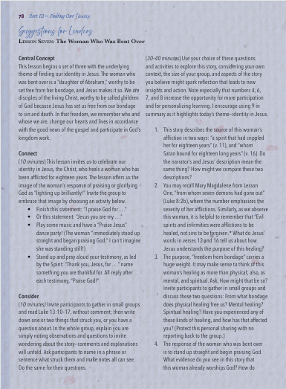
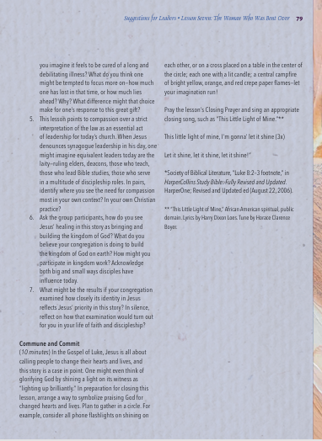
Suggestions for Leaders
Notes:
Before we begin discussing each of the lessons, I’d like for you to turn to any of the “Suggestions for Leaders” at the end of each of the lessons. The one I have a copy of on the slide is Lesson 7’s “Suggestions for Leaders” on pp. 78-79. These suggestions are intended to enhance a group’s study time together and make the study leader’s planning easier.
The suggestions included in for each of the lessons are pretty good – definitely better than many we’ve had in the past – so take advantage of these suggestions. In fact, if you are leading the lesson, you may want to start with the “Suggestions for Leaders” and refer back to the lesson pages as you go through each of these items. Then, add and delete items on things that will best fit your group of ladies.
Joyce MacKichan Walker divides things into 4 sections for each of the lessons:
Central Concept
Connect
Consider
Commune and Commit
Unlike last year, my role in this overview is NOT to outline how to present each lesson. What I will try to do in this overview is highlight some of the items suggested in the lesson and in the Suggestions for Leaders plus give you additional ideas, suggestions and resources.

Slide 9
Introduction
How do you bounce back from challenges?
Are you a rubber band?
  Resilience – snaps back after being stretched
  Need to be stretched to keep character
    Joy – attitude that depends on character
  Christ – Need a good anchor point
  Identity – Holds us / things together
Quotes
  “Humble yourselves before the Lord, and he will lift you up.” – James 4:10
  “God does His greatest work when we reach the end of ours.” – Pastor Jentezen Franklin
Notes:
Let’s turn back to pp. 10-11 and take a look at the “Introduction” of our study.
Pass out rubber bands to each person.
Have you had times when you snapped or felt broken? Sometimes we are stretched too thin because we say “Yes” too many times. Or, we may face a disaster or crisis that dumbfounds us or breaks our hearts. How do we bounce back when we’re met with those challenges?
CLICK I’ve given each of you a rubber band. Awhile back, I was reading about “rubber band faith”, and it reminded me of the themes discussed in our Bible study this year. Let me explain.
Resilience is like a rubber band. It snaps back into shape after being stretched too thin. It can be twisted into knots and bounces back into shape. If it’s not stretched every once & awhile, it becomes stiff & breaks. Being resilient means being able to bounce back from tough times or discouragements or hardships or defeats. People who survive and thrive well in change are resilient.
Just like a rubber band needs to be stretched, God also wants us to be stretched. We all have talents and skills, but we can only go so far. When we step out and stretch ourselves, God shows up and does what we cannot do by ourselves. That knowledge makes us bolder, more courageous, and brings us joy. And when we talk about joy, we are not really talking about happiness. Happiness is dictated more by external things and events. Joy is an attitude, and it depends on an internal character. We all need to be stretched to build our internal character, which will bring us joy. Joy is also 1 of the 7 Fruits of the Spirit, so it’s a feeling produced by the Holy Spirit.
Have you ever tried to shoot a rubber band across the room? You can do it many ways, but in all ways, you have to have a good anchor point. Unless we first put Christ into our lives, we are doomed to fail. The rubber band also helps us remember that being part of the Church of Jesus Christ means God is with us, holding us together, even when we are going through difficult circumstances. This becomes part of our identity – of being 1 of God’s children.
CLICK James 4:10 states it well: “Humble yourselves before the Lord, and he will lift you up.” Or as one pastor put it, “God does His greatest work when we reach the end of ours.”

Slide 10
Introduction
Intro suggestion: Discuss in small groups
  Which theme would you claim as a strength?
  Which theme do you most hope to grow in your life?
A quick, true story…
Scriptural quotes in study from NRSV
Notes:
There’s a suggestion for Lesson 1 on p. 20 of our book that you may want to use when introducing the study. It suggests breaking into groups of 2 or 3 people sitting near you and answering 2 questions, which are:
1. Which 1 of the 3 themes for this year’s study would you most claim as a strength you have – resilience, joy or identity?
2. Which 1 of the 3 themes for this year’s study do you most hope to grow in your life?
For time’s sake, we are not going to do this, but as we go through the overview, you may want to think about those 2 questions.
Let me tell you a quick, true story. A friend of mine was in the hospital with her dying husband. She had lots of people coming by to see her husband and to support her – some were family or friends, some were church family. There was another lady in the room next door whose husband was also dying. No one came to see her or her husband. The lady with no one said to my friend, “I wish I had someone to be with me at this difficult time.” My friend said, “Do you have a church? Then, you need to call them and let them know what is going on.” The lady called her church, and an hour later someone was there to be with her and comfort her.
It is through Christ we find resilience, joy, identity and comfort.
We will always face challenges. This year’s study will use biblical teachings to help us navigate through those times by exploring how our resilience, joy and identity can strengthen us because of our connection with Jesus Christ. One of the things I found in going through this study is how many times I said to myself, “This story about resilience is also a lesson about joy or about identity.” It was amazing how much they were interconnected. Feel free to show that interconnection as you go through the lessons with your group.
Also, as a point of reference, I believe all of the quotes from the various passages in our study book come from the New Revised Standard Version of the Bible.

Slide 11
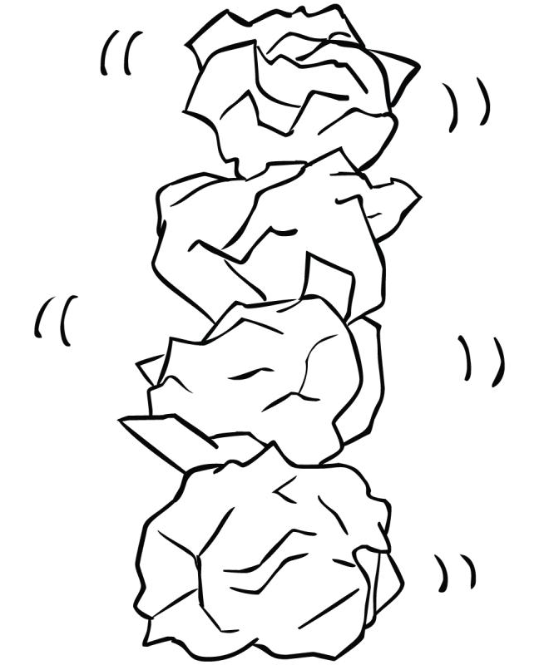
Finding our Resilience in Jesus Christ
Paper Stone Stacking
Notes:
So, let’s begin with “resilience”. I want to start by reading how our book defines “resilience”. It is the ability to spring back into shape and to adapt well in the face of adversity, trauma, tragedy, threats, or stress – such as from family, relationships, health, workplace, and financial stressors. People who survive and thrive well in change are resilient.
So, let’s try a 3-minute exercise to see how you handle it. It’s called “Paper Stone Stacking”.
Each of you have 5 sheets of paper.
On each sheet write an adversity, trauma, tragedy, threat or stress in your life. Don’t think about it, just write a word or two for each item.
Crumple each sheet tightly into a “stone” so you have 5 stones from the 5 sheets of paper.
Now, I will give you 30 seconds or so to stack and balance all 5 stones on top of each other.
How did you do?
This exercise calls for mindfulness, focus, trial and error, patience, and of course, resilience.
And that’s resilience – the ability and the willingness to get back up again when you’re down and use trial and error to overcome when we are tested.
So now, let’s look at the 3 lessons for the theme of resilience.

Slide 12
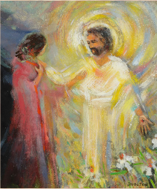
Lesson One
Mary Magdalene, the Tower
Tell me about Mary Magdalene
  Healed of 7 demons by Jesus
  Devoted follower of Jesus
  Name usually listed 1st
  Present @ crucifixion
  Witnessed Jesus’ resurrection
  Became 1st evangelist = Apostles’ Apostle
Mary is common name
  Mary mother of Jesus
  Mary mother of James
  Mary wife of Clopas
  Mary Magdalene
List of Mary Magdalene in Gospels
Activity, p. 17 = good questions to discuss
  Mary of Bethany
  Mary mother of John Mark (Gospel author)
  Mary of Rome
Notes:
Have you ever felt defined by your past or wondered if you could overcome mistakes or struggles?
The first lesson is about Mary Magdalene, and Mary Magdalene’s story reminds us that our faith is strengthened by and restored from God.
Tell me what you know about Mary Magdalene. (After answers given, CLICK to reveal bullets.)
Jesus healed her of 7 demons
Follower of Jesus
Since her name is usually listed first, she seems to be the leader of the women followers or maybe the eldest.
Present at the crucifixion
Goes to the tomb after the Sabbath to complete Jesus’ body for burial
Jesus appears to Mary at the empty tomb. She doesn’t recognize Jesus at first until He calls her name.
Jesus tells her to go and inform the disciples about His resurrection, becoming the first evangelist, or what some people describe as the Apostles’ Apostle.
Mary’s journey from brokenness to becoming a devoted disciple of Jesus, as well as the first witness to Jesus’ resurrection offers hope, courage and inspiration to all of us. Hers is a story of resilience.
The name “Mary” is mentioned more than 50 times in the Bible, but only in the New Testament. That’s because Mary is the Greek form of the Hebrew name Miriam. The name Mary was so common that the Gospels had to specify which Mary they were talking about. In Luke 8:2 it tells how in Jesus’ inner circle of followers there were Mary the mother of Jesus, Mary the mother of James, Mary the wife of Clopas, and Mary called Magdalene. An interesting fact, there were 3 Mary’s present at the cross. For your information, I’ve listed on the slide the 7 Mary’s of the New Testament.
Mary Magdalene was the ONLY person mentioned in all 4 Gospels because they all tell how she went to the tomb of Jesus on Easter morning. Remember, there was a different audience and purpose for each of the Gospels. But this shows how important a role Mary Magdalene, the Tower, played in the purpose for each of the Gospels. With your handouts I have a sheet titled “13 Bible Results for ‘Mary Magdalene’ in Gospels” that lists all of the references about Mary Magdalene in each of the 4 Gospels.
Also, the “Activity” listed on p. 17 of our book suggests: “Imagine that you are a woman disciple of Jesus. It is both exhilarating and challenging. Write some of the things that you would like to see, say, or do. When you see Mary the Tower, what might you say to her?” These might be good questions to discuss in your group.

Slide 13
Lesson One
Mary Magdalene, the Tower
Controversial Topics
Magdala
  Town / Not town in 1st century
  Magdala = “Tower” or “Great”
    Profound transformation
    Like stages of a Butterfly
    Probably older, more educated, maybe wealthier
Mary from Bethany
  Lazarus’ sister?
  Interesting theory - may or may not be true
  NOT new info, new INTERPRETATION of info
  No punctuation in old Latin / Greek / Hebrew
  Many errors in translations
  Focus on the strong & resilient Mary
Notes:
Now, let us tackle some of the controversial topics in this lesson. I am not really sure why our author includes these items because there is no bearing on the topic of the study, but they could be interesting discussion points.
You have probably grown up, like I have, believing that Mary Magdalene came from the town of Magdala, and that is why she is called Mary Magdalene. On p. 14 under “What’s in a Name?”, our author disputes that claim. She states that research done by Mary Ann Beavis shows that no town existed by that name in the 1st century. However, archaeological excavations conducted in 2006 found that Magdala settlement is about 3 miles north of Tiberias. In Aramaic (which is the common spoken language of Hebrews) it was known as Magdala Nunaiya (Nu-nai-ya), which means “Tower of the Fishes”, and in Greek it was sometimes called Tarichaea, “the place of processing fish”. Several Hebrew, Greek and Roman scholars from the 1st century BC and 1st century AD, such as Josephus, Strabo, Pliny the Elder, Cicero and Suetonius mention the importance of this town because of its excellent salted fish and important Roman markets. Magdala began between the 2nd and 1st centuries BC and ended during the late Roman period, which would be the 3rd century AD. Later excavations in 2009-2013 as well as one in 2021 confirm the Magdala settlement dates of the 2006 excavations.
Our author gives an alternative reason Mary might have been called Mary Magdalene. In Hebrew, Magdala’s name does mean “tower” and symbolizes strength and resilience, which reflects Mary’s unwavering devotion to Jesus. Her journey following Jesus is a profound transformation from someone burdened by spiritual oppression to a disciple who played a pivotal role in the resurrection story. In some ways, Mary reminds me of a butterfly that is transformed from a caterpillar to being trapped in a cocoon or chrysalis to turning into a beautiful butterfly that can fly. The same is true with us. When we let Jesus into our heart, we go through a transformation or conversion and become a new creation.
We do have evidence that Mary Magdalene was a strong, resilient woman. Her name is usually listed first, except when listed with Jesus’ mother Mary. Usually this means she would either be the oldest of the people being listed or she has more authority or money or education than the others listed. That definitely fits with a nickname meaning “tower” or “great”.
CLICK Also, our author states that Mary Magdalene was from Bethany and was Lazarus’ sister and there was only Mary, not Mary and Martha. She gets those opinions from Dr. Elizabeth Schrader Polczer.
This is an interesting theory, but there are many other theories about “hidden messages” in the 4 Gospels that can lead readers to question the authenticity of the Gospels. In interviews Schrader Polczer tells how this is based on her theories, and that it may or may not be true.
As our book tells us, Schrader Polczer states how the various versions of the Bible state different things and have some things written in the margins, such as the name “Martha” next to the name “Mary”. However, if you have ever visited the Bible Museum as Houston Christian University in Houston, the tour guide will tell you how several times the scribes that transcribed the Bible sometimes would miss words or replace words they thought would fit better or modify a statement based on the preference of the king of that particular time. She will also show you have some have words written in the margins. I would say what Schrader Polczer is stating is NOT new information, but a new INTERPRETATION of old information.
Plus, there was no punctuation in ancient Latin, Greek and Hebrew, so it was up to the individual’s interpretation on meanings.
For instance, if I said, “She can’t help herself,” it could mean a woman is handicapped and physically not able to assist herself in performing certain tasks. Or, it could mean in our colloquialism that the woman in question can’t RESIST doing something; they’re too weak to say NO to themselves. You can easily see how hard it must have been to translate the Bible.
Think about how many typing errors you have on a text message or email that is only a few sentences. Now, think of how many errors you might have if you were translating the entire Bible by hand.
Let me give you an example that bring home this point of how missing words and mistakes were very common in translations throughout the years. The most common version of the Bible in the world today is the King James Version (KJV), which was published in 1611. The reason KJV was done is because there were so many mistakes in the previous biblical versions. Then, in 1885, several dozen British and American scholars for over a decade published a new English translation of the KJV. It was called the English Revised Version. Those scholars found over 1000 errors in the KJV.
So, I took Schrader Polczer’s suggestion as an interesting thought, but I would focus the lesson on Mary Magdalene being strong and resilient, not on an interesting theory.

Slide 14
Lesson One
Mary Magdalene, the Tower
Discussed from 7:00-9:00 min. mark on DVD
  Discussion questions on p. 21
PDF – “The Gospel of Mary Magdalene”
  Discovered 1896 w/ other Gnostic writings
  Written in 2nd century, past Mary’s lifetime
  Missing 6 pp @ beginning & 4 pp in middle
  https://www.thegospelofmary.org/the-gospel
Video – “Mary Magdalene & the Gospel of John with Elizabeth Schrader”
  Info on p. 103 of “Annotated Bibliography”
  https://youtu.be/_b3Y3cJ0Ic8
Video – “Mary or Martha?”
  https://today.duke.edu/2019/06/mary-or-martha-duke-scholars-research-finds-mary-magdalene-downplayed-new-testament-scribes
Notes:
If you or your group want to delve more into these ideas, you may want to play for your group the DVD for this part of the lesson where our author discusses this topic. It is basically from the 7:00 minute mark to about the 9:00 minute mark of Lesson One on the DVD. On the DVD the author tells how she had recently heard Schrader Polczer’s lecture on the subject and had met her.
At the bottom of the left column on p. 21 of the “Suggestions for Leaders” there are 3 discussion questions that might help your group process this new theory.
If you are interested in more information about the Gospel of Mary, which is referenced in the author’s footnotes, as well as information by Dr. Elizabeth Schrader Polczer, you can find reference material about her research on p. 103 of Annotated Bibliography” as well as going to the links listed on this slide.

Slide 15
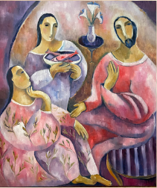
Lesson Two
Mary of a Certain Village
Main Idea
  spend time listening to & learning from Jesus
May want to listen to DVD for explanation
  Story in John = Mary’s role = 3 women to down-play prominence, from Bethany, Lazarus’ sister
  Story in Luke = Martha and Mary, no brother
When reading Luke 10:38-42
  Focus on the passage & resiliency of Mary
  v38 – “a certain village”
  Martha invited Jesus; being hospitable
  Mary @ Jesus’ feet to learn to be a disciple
  v40 – Calls Jesus Lord, then tells Him what to do
  v40 – Martha “distracted”; spiritual food priority
  What distracts you?
  Jesus called men & women to spread good news
Notes:
The main idea for this lesson is the resilience to spend time listening to and learning from Jesus as a follower of Christ.
If your group likes to listen to what the author has to say about the lesson instead of reading various parts from the book, then this lesson might be a good one to do just that. Most of what she says in the book she repeats on the DVD, including the story about her sister and herself that she tells on p. 24.
Again, the author is using research from Dr. Elizabeth Schrader Polczer as the basis for some of the information in Lesson 2. The author explains on the DVD that Schrader Polczer believes Mary Magdalene’s role was split into 3 women (Mary Magdalene, Martha, and Martha’s sister Mary) in John’s Gospel to downplay Mary Magdalene’s prominence. But she believes there was a Martha and Mary who were sisters in the Gospel of Luke. Schrader Polczer also believes Mary Magdalene was the sister of Lazarus in the Gospel of John. However, Lazarus is not mentioned in the Gospel of Luke, so she believes Luke’s Martha and Mary did not have a brother named Lazarus.
In my opinion, that is taking a great deal of liberty with the story. There are many logical explanations why Lazarus is not mentioned in this story. Also, we remember that Luke only includes facts told to him by eyewitnesses. So, it is likely that the account told to him did not contain the town they lived in or any other people besides Mary and Martha. It might be that Luke’s focus was making prominent the relation of the two sisters with Jesus. (FYI… Although these first 2 lessons have some controversaries, the rest of the lessons are not controversial to what we have learned in the past.)
Therefore, when reading the passage, focus on the story at hand and the resiliency of Mary to go against what was expected so she could listen to what Jesus was teaching. Again, the “Suggestions for Leaders” has some great ideas on how to lead the lesson.
A few items you may want to bring up about the passage:
Verse 38 of the New Revised Standard Version Updated Edition (NRSVUE) uses the phrase “a certain village”, which is where our author gets the title of the lesson “Mary of a Certain Village”.
Notice, it is Martha who invites Jesus into her home, which is very rare for a woman to own property. It does not say Mary and Martha own the home, just Martha. It implies Marth was older, maybe much older, than Mary. What Martha is doing is not bad. She is being a hospitable host, which was what was expected of women at that time. In the ancient near-eastern culture of Jesus’ day, hospitality was a responsibility and a matter of honor to entertain guests. And, matters of honor were not taken lightly. I just got back from visiting Greece and Turkey, and I was a witness to this idea even today. Plus, when Jesus appears with 12 hungry men (and who knows how many other followers), social custom required the sisters to provide a generous meal. This task would be daunting even with both of them working together.
Mary sitting at Jesus’ feet to listen to him teach is completely against what first century women were to do. It may be that Mary is actually sitting at Jesus’ feet, but it may be that she is just sitting and listening intently trying to learn all she can so she can be a disciple of Jesus. For instance, in Acts 22:3, Paul tells how he was educated at the feet of Gamaliel. This is countercultural to what first century women were to do.
In verse 40 Martha calls Jesus, “Lord,” but then she tells Jesus what to do. The term "Lord" or “Master” refers to someone in authority over others. Do you do something similar in your prayers? For instance, do you ever say, “God, will you fix the problem I am having because I don’t know what to do?” Instead, maybe you should pray, “God, how do you want me to respond to this hardship?”
Also, verse 40 tells how Martha was “distracted” by her many tasks. It is not that she was not able to handle the work, but she was choosing to DO something special for Jesus, as was expected from women at this time. Maybe her distraction was she was jealous that she was not doing exactly what Mary was doing. But Jesus did not need anything done special for Him. Maybe Martha’s distraction was to do good and listen to Jesus. But Jesus’ desire was He wanted Martha to be focused on His teachings. He wants the same thing from us, too. Spiritual food takes precedence over physical food.
You may want to discuss as a group things that distract us from spending time with Jesus.
Perhaps another significant lesson for us today is Jesus called men and WOMEN to proclaim the good news of salvation. The Jews actually had a higher view than many other cultures in biblical times. But it still was bad. Jesus started a revolution with a complete 180-degree turn from the way women were treated at this time.

Slide 16
Lesson Two
Mary of a Certain Village
Video – from the series “The Chosen”
  https://youtu.be/C3NsmjQTjl4?feature=shared (3:25)
Martha opened her home to Jesus;
Mary opened her heart to Jesus
Spending Time with Jesus
  Why is it important to spend time w/ Jesus?
  What’s your favorite time to spend w/ Jesus?
  Choose a day to plan 1 less thing than normal
  Use that time to spend time w/ Jesus
  “Commune & Commit” on p. 31 has good ideas
Notes:
I’ve included on the slide a link to the portion of the TV series, The Chosen, about the last part of Mary and Martha’s story. As usual, they take a little liberty with the text, but I thought the explanation Jesus gave Martha was very good. You may want to show this short clip after your discussion about the passage. https://youtu.be/C3NsmjQTjl4?feature=shared (3:25)
Martha opened her home to Jesus and His disciples. But Mary opened her heart by making time for Jesus and listening to Jesus’ teachings. You may want to discuss how both are important but why listening and learning from Jesus, especially when the Son of God is there with you, is more important.
We all need to spend some time with Jesus.
You may want to start by asking your group why it is important to spend time with Jesus.
Follow up with what their favorite time of day is to spend with Jesus?
You may need to suggest they choose a day where the ladies can plan one less thing than normal.
Then, they can use that time to read aloud some of Jesus’ word or do some of the things listed in the “Suggestions for Leaders” under “Commune and Commit” on page 31.

Slide 17
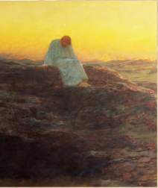
Lesson Three
Jesus is Tested
Main Idea – Not alone during difficulties
  Chance to discover trust & reliance on God
  Develop integrity
  Divine plan for us to be tested
  Some stress can energize & motivate us
  Challenges provide growth & spiritual renewal
Jesus tested 3 times in wilderness by devil
  Good suggestions & questions in book
  Right after His baptism
  Spirit led Jesus into wilderness to be tested
  Devil waited until Jesus was “nearly depleted”
  3 places, 3 different temptations
  Devil departed until an opportune time
  This story can only come from Jesus
What does Jesus do to stay resilient?
Notes:
Lesson 3’s main idea is that we are not alone during difficulties. You may want to ask your group of ladies what it means to them that God is with them when they are going through difficulties. On the slide, I listed 5 items that concept or idea can help us understand and develop.
Chance to discover trust and reliance on God
Develop integrity
Divine plan for us to be tested
Some stress can energize and motivate us
Challenges provide growth and spiritual renewal
Jesus was tested 3 times in the wilderness by the devil.
Both of the ideas suggested in the “Activity” boxes on pp. 34 and 36 are good. Also, there are several good suggestions and questions included in the “Suggestions for Leaders”, especially the idea of reading the passage with 3 voices. The “Suggestions for Leaders” also give you ideas for different openings and closings.
A few things to point out, Jesus’ testing happened right after His baptism, when He was filled with the Spirit.
Our book describes how it was part of God’s plan for Jesus to be tested because it was the Spirit that led Jesus into the wilderness.
Just as the devil waited until Jesus was “nearly depleted” before tempting Him, we too can find ourselves most vulnerable when we are exhausted or tired or near our “rope’s end”. You may want to discuss how important it is to know who we are and whose we are.
Take note how Jesus’ tests occur in 3 different places with 3 different temptations. You may want to use 3 objects to represent the desert, the high place, and Jerusalem to drive home that point. Ask the questions: “Who gave Jesus power to resist the devil?” “Was there ever a time when God’s Spirit helped you say no to doing or saying something wrong?”
Just above the title “Testing as Teaching” at the bottom left corner of p. 35, it tells how the devil doesn’t leave defeated but leaves until an opportune time. When was that opportune time? Looks like one opportune time was around Jesus’ crucifixion time.
This story can only come from Jesus because only Jesus and the devil were there. Yet the story is told in Matthew, Mark and Luke, so Jesus told someone.
As we learned from our study 2 years ago, Luke only included stories where he interviewed people that told him the story first-hand. Since we know Luke interviewed Jesus’ mother, Mary, I can picture Jesus and Mary talking about these temptations Jesus encountered. But, it’s only a speculation. Jesus could’ve told all of the disciples to show how we all go through tests.
What does Jesus do to stay resilient? (At the top of p. 35, our book tells us that Jesus fasts, prays, studies and interprets scripture.) So, what can we do to stay resilient?
Also notice, with each test from the devil, Jesus quotes back scripture as His answer. The answers for what we need to do are all in the scriptures.
Just as a side comment, at the top, right column on p. 34, I believe the editor / proofreader missed modifying a subtitle. I believe the subtitle, “Mary the Tower is a Model of Resilience” should say “Jesus is a Model of Resilience”.

Slide 18
Lesson Three
Jesus is Tested
What’s meaning of 3 in Bible?
  Divine completeness
Jesus tested 3 times at crucifixion by devil
  Spirit led Jesus into situation to be tested
  Devil sees “an opportune time”
  Devil waited until Jesus was “nearly depleted”
  3 different people, 3 different temptations
Testing → Teaching
  Part of human experience
  Trust & rely on God
Story of the Soldier & the Spider
  https://www.creativebiblestudy.com/Christian-stories.html
  https://youtu.be/H-v0NnlIi8U - video
“We Are Not Alone” hymn – videos
Notes:
The number 3 in the Bible symbolizes divine completeness and is associated with the triune nature of God (Father, Son, and Holy Spirit). It is used about 467 times in the Bible, depending on your translation. And, our author uses this topic for Lesson 3.
I never thought about this before, but on p. 34 of our book it shows how Jesus is tested 3 times just before and during His crucifixion by the devil. Again, it is 3 times He is tempted.
The Spirit led Jesus into a situation to be tested.
The devil sees “an opportune time” to test the Son of God.
The devil waited until Jesus was “nearly depleted”.
There are 3 different people with 3 different temptations.
On p. 35 there is a section titled “Testing as Teaching”. If you look at the last paragraph of that section, 2 things from are highlighted about us.
We do not want to be tested, but it is part of the human experience.
And, we can endure hard times by trusting God to handle whatever else is thrown our way.
CLICK And when I read that, it reminded me of a wonderful story that I often use as an example of putting our trust in God to get us through hard times. It is called the “Story of the Soldier & the Spider”. I have included links to the story and the video.
https://www.creativebiblestudy.com/Christian-stories.html - story
https://youtu.be/H-v0NnlIi8U - video
I have put in the notes the link to the “We Are Not Alone” hymn video mentioned in the “Suggestions for Leaders”, plus I included 2 other videos of the song.
https://youtu.be/5wvtawnpz3w?feature=shared
https://youtu.be/3k5mYHYsUAc?feature=shared
https://youtu.be/Q0_vbMEdONo?feature=shared
Also, the hymn “When We Are Tested”, which is included in the Suggestions for Leaders, is sung to the tune of “Be Thou My Vision”, if you should sing that song as your closing prayer.

Slide 19
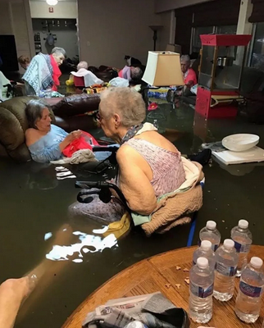
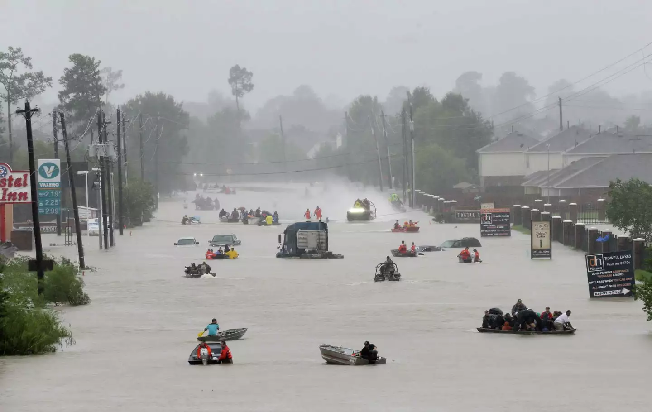
Hurricane Harvey, 2018
Notes:
On p. 39, the “Suggestions for Leaders” for Lesson 3 talks about Hurricane Helene in October 2024 that hit the Carolinas, but I would suggest talking about a disaster that is closer to your home.
For the Houston area, we have lots of storms that could be discussed. But Hurricane Harvey in 2018 would be an ideal topic to talk about resilience.
The 2 pictures I have on this slide show how people who were facing adversity, stress, trauma, tragedy, and threats to their life were handling things.
The picture on the left shows how neighbors were helping neighbors get out of their flooded homes by using boats to go back into the neighborhoods. They were adapting to their situation.
The picture on the right is an amazing picture where these elderly people in a nursing home are sitting in about 2 feet of water. But look closer at the picture. Do you see the woman in the middle in the recliner that is hand sewing something? She is definitely persevering.
Our book tells us, “Stress is not always bad. A certain amount of stress can energize and motivate us to achieve our purpose.” We have examples throughout our lives and our history of how various adversities brought about ways of overcoming and surviving and thriving. Often new inventions come from something that stresses us and motivates us to find a better way.

Slide 20
Finding our Joy in Jesus Christ
Joy vs. Happiness
https://youtu.be/4uNQnvaGrxQ?feature=shared (4:44)
https://youtu.be/KLfDry1Y_fQ?feature=shared (2:05)
Notes:
In the Introduction to our study, it tells how joy is often confused with happiness. So, I’ve included 2 videos to help tell and show people the difference between joy and happiness.
https://youtu.be/4uNQnvaGrxQ?feature=shared
https://youtu.be/KLfDry1Y_fQ?feature=shared
Both of these videos are similar using the same idea to explain the difference between happiness and joy. For time’s sake, I’m going to do the experiment but just explain it.
There are 2 blown-up balloons.
One of the balloons has some water in it and represents “joy”.
The other balloon with no water represents “happiness”.
One video uses a lit candle and the other video uses a lighter to represent when things go wrong or do not go our way.
When you put the “happiness” balloon with no water in it over the candle or lighter flame, the balloon pops.
When bad things happen, it can destroy our happiness.
But when you put the “joy” balloon with some water – and the water represents being filled with the Holy Spirit – over the candle or lighter flame, the balloon does not pop.
Our joy comes from knowing God and knowing that he is always with us – even when difficult things happen, even when we're feeling sad.

Slide 21
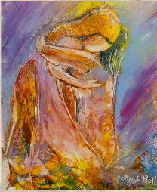
Lesson Four
The Prodigal Child, the Eldest
Child, and the Devoted Parent
Main Idea – We’re beloved children of God
  God has unconditional love & forgiveness
  Importance of repentance & returning to God
  Those who stay should embrace those who return
Introduction Illustration
  Save food scraps for a few days
  “Someone in today’s passage wanted to eat this”
  After guesses, open lid & smell / see scraps
Prodigal - Wasteful, particularly w/ money
“Consider” section activities on pp. 48-49
  Divide into 3 groups to follow each character
  Giving son shoes = inviting him into household
  Similar to God’s grace to us
  Reading story in book with 3 women characters
Notes:
Main Idea – We’re beloved children of God. But I added to the slide 3 additional ideas I got from this story:
God has unconditional love and forgiveness for us.
We cannot understate the importance of repentance and returning to the Father.
There is a need for those who stay to then embrace when others return.
Here’s a good introduction illustration. Save your food scraps in a well-covered container for a few days before you meet. When the group meets, tell how the container holds something someone in one of Jesus’ parables wanted to eat. After giving time for guesses, open container and let them smell and see the disgusting scraps.
Today, we don’t use the word “prodigal” in our every-day language, except for this parable in the Bible. Prodigal means "wasteful“ – particularly with regard to money. It indicates a person who wastes money by spending with reckless abandon.
I thought the ideas in the “Consider” section of the “Suggestions for Leaders” on pp. 48-49 were good ideas.
Starting out by dividing your total group into 3 smaller groups, giving each group one of the 3 characters to think about the questions included at the top, right of the page as they follow the reading of the Luke 15:11-32.
By the way, something you may not know, in verse 19 the returning son told his father to treat him like one of his hired hands. In verse 22 of the passage the father tells the servants to bring sandals for his returning son. Slaves went without shoes. So, giving him shoes meant the Father was inviting the son back into his household.
This is similar to God’s grace to us. Grace is the unearned, undeserved and unmerited favor of God. The story of the prodigal son shows grace at its richest. Grace is not logical. It doesn’t give us what we deserve. The heart of the Father in Luke 15 reveals God’s nature: He is slow to anger, abounding in love, and quick to forgive.
Then, reading the story on pp. 42-43 that is a more modern-day version with 3 women instead of 3 men. It helps to give a different point of view.

Slide 22
Lesson Four
Additional Reflection Questions
  What do you buy that aren’t essential?
  What God-given gifts have you wasted?
  Have you ever been like the older son in story?
  What surprises you most about each character?
Joy vs. Pleasure – Break into Small Groups
  What gives you pleasure? What gives you joy?
  Joy lasts forever; pleasure is self-centered
  Ecclesiastes 2 – w/o God, there’s no joy
#4 Reflection Question – Forgiveness
  Powerful tool to move from past to happier life
  Key to happy & healthy life
Activity on p. 45 – Serve “Banquet” Lunch
Philippians 4:4-8 Benediction on p. 49
Notes:
I’ve included “Additional Reflection Questions” you might ask your group.
What things do you buy that aren’t essential in your life?
What physical gifts has God given you that you have wasted?
Have you ever been like the older son in the story?
What surprises you most about the younger son? The older son? The father?
Another topic that would be good for discussion for this lesson is the difference between Joy and Pleasure or Happiness.
Our book uses the story of the woman that lost a coin, which is included in the verses just before the story of the Prodigal Son. But you could have the ladies break into small groups and to share with each other things that give them pleasure or happiness. Then, have them share what brings them joy.
We assume the only way to have joy is by the acquisition of pleasure. But as King Solomon tells us in Ecclesiastes 2, the more pleasure we acquire, the less joy we possess. In Solomon’s pursuit of pleasure, he found all of wealth and power and wisdom was meaningless and futile in the grand scheme of life. So often seeking pleasure in things is being self-centered. Pleasure alone fails to offer lasting satisfaction or purpose. Solomon ultimately concluded that without God, there is no joy.
Another good question for discussion is the 4th Reflection Question on p. 46 – What does this parable teach us about repentance and forgiveness? Forgiveness is a powerful tool that can help us move on from our past and towards living a happier life. And, this story helps us to see that God never gets tired of finding those that are lost and giving His love and forgiveness away.
Looking at the “Activity” listed on p. 45, you may want to serve lunch at the end of the lesson to imitate a banquet to celebrate the joy of someone who returns after being lost.
Finally, before doing the Closing Prayer or afterwards, you may want to share Philippians 4:4-8, which is on p. 49, the very last item for the “Suggestions for Leaders”. However, even though it says the verses included in our book are Philippians 4:4-8, they have actually included only Philippians 4:4-7. You need to go back and get the 8th verse because it is a good one.

Slide 23
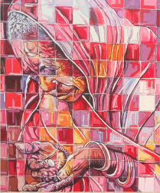
Lesson Five
The Gift of the Woman
Who Was Poor
Which Comes First?
  Time to a Cause or Financial Support?
  Generosity or Gratitude?
  Faith or Action?
  Joy or Generosity?
  Gratitude or Joy?
Main Idea – Generosity, gratitude, joy abound
What is Christian joy?
  A good feeling in the soul
  A feeling, not idea/conviction/persuasion/decision
  A fruit of the Spirit when you become believer
  Causes us to see beauty of Christian Word & World
  Only thing that can steal our joy is sin
Have an attitude of gratitude
Notes:
Now, Lesson 5, “The Gift of the Woman Who Was Poor”.
I’m going to call out some “which comes first” statements – like, “Which comes first, the chicken or the egg.” Everyone must choose an answer, then tell your partner why you chose that answer. There is no right or wrong answer to any of these questions. It’s just to get you to think about the questions.
Which comes first, giving time to a cause you support or giving financial support?
Which comes first, generosity or gratitude?
Which comes first, faith or action?
Which comes first, joy or generosity?
Which comes first, gratitude or joy?
This is 1 of 2 introductions to this lesson that is included in your “Suggestions for Leaders”; both of the suggestions are great ideas. In fact, I found the “Suggestions for Leaders” for this lesson were well thought out and flowed nicely. But, of course, I have a few additional suggestions.
The main idea for this lesson is around generosity, gratitude and joy abound. The author begins Lesson 5 by describing these things as part of Christian joy. So, ask the ladies, “What is Christian joy?”
We can define Christian joy as:
A good feeling in the soul.
It’s not an idea, nor a conviction, nor a persuasion or a decision. It’s a feeling.
That feeling is produced by the Holy Spirit, since Joy is one of the 7 Fruits of the Spirit as Paul tells us in Galatians 5:22-23.
It’s the Holy Spirit that causes us to see the beauty of Christ in the Word and in the World, even when things are not going well. Our inner joy is never taken away. We can still rejoice in the fact that we are forgiven children of God who enjoy an intimate relationship with Him. Our joy is strengthened when we remember that God is with us always and He is above all else.
The only thing that can steal our joy is sin.
At the top of p. 55, our author talks about “Finding Our Joy”. And one of the best ways to find joy is to have an attitude of gratitude. That attitude of gratitude reflects God's love and grace with every act of generosity we share with others.
At the bottom of the left column of page 59 it says,
“It’s not about us and this moment. It’s about God and God’s faithfulness. It’s about Jesus and his life and teaching. It’s about the Holy Spirit working in the world, even now, to bring about God’s kingdom. It’s about trusting that no matter what is going on in our lives, how we feel, what we are dealing with, underneath are ‘the everlasting arms.’ Those ‘arms’ are very often the community of faith called the church that gives us a home, feeds us at the table of grace and joy, and surrounds us with love and support. And always remember: We are not alone. We live in God’s world. In life and in death we belong to God.”

Slide 24
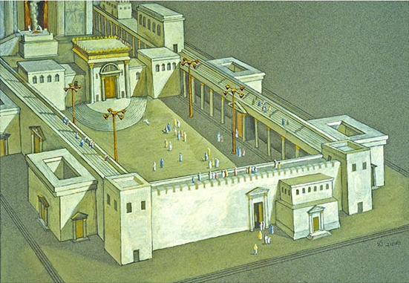
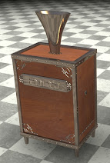
Scripture – Mark 12:42-44
  Temple Treasury = 13 wooden boxes w/ trumpet-shaped bronze funnels
  Each chest designated for specific contribution
  Boxes placed under colonnades of Court of the Women
  Supported worship, daily sacrifices, maintenance, provisions for priests/Levites
  Giving sign of faith / obedience / devotion; reflecting heart of giver
Widow dependent on landowners’
generosity
2 mites
  Smallest coin @ time
  Today, 1/8 of penny
Not lesson on tithing,
but on sacrifice of love
Notes:
Our scripture for Lesson 5 is Mark 12:42-44. It is also in Luke 21:1-4. I want to share a few things not covered in scripture or by our author that may help you understand the story a little better.
The Court of Gentiles was the outer court where everyone was allowed to come in. Through the Beautiful Gate you could go into the Court of the Women which mainly functioned as the place for Jewish women to worship and participate in temple rituals because women could not enter the inner courts. It was not exclusively for women; men could also enter this area. The Court of Women was a rectangle about the size of a hockey court, which was surrounded by a colonnade.
People deposited their offerings into 13 wooden boxes with trumpet-shaped bronze funnels to guide the coins into the box. These boxes were known as “shofar chests”, probably similar to the picture on this slide.
Each chest was designated for specific types of contributions. Five of the 13 shofar chests were for voluntary offerings while the others were for collecting specific offerings to support the needs of the Temple, like temple tax and funds for the purchase of sacrificial animals.
These boxes were placed under the colonnades that encircled the Court of the Women of Herod’s Temple Mount.
The treasury supported various aspects of temple worship, including the daily sacrifices, maintenance of the temple complex, and provision for the priests and Levites.
The act of giving to the treasury was an expression of faith, obedience, and devotion, reflecting the heart of the giver more than the amount given. The offering also served as a reminder of God's provision and the importance of stewardship.
As a widow, the woman would have been dependent on the generosity of those landowners who were following the Mosaic Law of Deuteronomy 24:19-21, which tells how they are to leave some of their crops for foreigners, orphans and widows.
Somehow, she came in possession of 2 mites, which is an insignificant sum of money. (Reminds me of how I found over 50 cents of coins on the sidewalks in New York City in less than an hour. Maybe that’s similar to how she came in possession of 2 mites.) The mite was the smallest coin used in New Testament time. At the time of Mark’s writing, a mite was worth 1/64 of a denarius, which was a day’s wage for a common worker. Today, the estimated value of a mite is about 1/8 of a penny.
The woman’s generosity in this story is more than a lesson on tithing. The poor widow understood sacrifice. She loved God enough to give Him all she had. Her heart was in the right place. The widow gave, not because she could, but because she wanted to. It was a sacrifice of love.
She gave a willing sacrifice because she trusted in God as the source of all she had. The courage and generosity of the widow who gave everything inspires us to look at our priorities. When we look at the world, do we see scarcity and worry about not having enough? Or, do we see the One whose presence transforms enough into abundance?

Slide 25
God loves a cheerful giver – 2 Cor. 9:7-8
Ways to be a Cheerful Giver
  Time
  Talent
  Treasure
Philippians 2:14
The Happiness Trifecta
  Dopamine, Serotonin & Oxytocin
  Chemicals contribute to improved mood & health
Provide opportunities to give
Lesson Five
The Gift of the Woman
Who Was Poor
Notes:
When we give out of obligation or with a begrudging heart, we miss the joy that God wants us to experience. Instead, we should focus on giving from a place of joy and understanding that our gifts, no matter how small, can make a significant impact.
Paul emphasizes that idea in 2 Corinthians 9:7-8 which he ends with the statement, “God loves a cheerful giver.” Just as is the message of this lesson, this passage highlights the importance of the attitude behind our giving. It's not the size of the gift that matters, but the heart and intention with which it is given. It is a shift in perspective.
Another idea that you may want to do with the ladies in your Bible Study group is to list Ways to be a Cheerful Giver. On the back of one of your pages create 3 columns. Title the first column “Time”, the second “Talent”, and the third “Treasure”. Now, let’s list things you do or can do.
Time Column: The gift of time means just that: volunteering your own time to help others. List some things you currently do or might be able to do to help others. Do you visit people in nursing homes? Help make or serve meals? Organize food drives? Teach a Sunday School or Bible class? Help with VBS? Serve as a deacon or elder? Help someone in need?
Talent Column: Are you able to offer your professional expertise to a charity or your church? Can you knit or crochet a sweater or hat or blanket to give to others? Can you sing in the church choir or play an instrument? Do you have another skill or hobby that others might need?
Treasure Column: Do you tithe? Do you donate to a charity with money or food or school supplies or clothes or blankets or any other items? Do you donate items you no longer need to charity groups?
This is just a good way for the ladies to focus on what they are doing and what else they could be doing.
Philippians 2:14 encourages us to do everything without complaining or arguing. This also applies to your giving. And the story of the widow woman who was poor is a great example of this.
The Happiness Trifecta: Did you know that giving triggers the release of 3 key neurochemicals?
1. Dopamine: Associated with motivation and arousal.
2. Serotonin: Linked to sleep, digestion, memory, learning, and appetite.
3. Oxytocin: Known as the “cuddle hormone,” it enhances bonding, reduces social fears, and promotes trust and empathy.
And guess what? These chemicals collectively contribute to an improved mood and overall well-being, which means giving makes you happier.
A possible idea to help embrace the Christian joy of giving is to brainstorm with your group how you, as a group, might be able to share your time, talent and/or treasure with others.

Slide 26
Notes:
Hold up a white piece of paper with a black dot on it. Ask: “What do you see?” (Most, if not all, will say they see a black dot.)
Ask, "Do you see anything other than the dot?“ If the answer comes back still nothing is seen but the black dot, the speaker says, "I'm really surprised. You have completely overlooked the most important thing of all - the dot you see is on PAPER, right? Do you think it is interesting that you looked so hard and never even noticed that the dot was ON paper?"
That tends to be the way we are in life as well. We all have problems that come up every day. Some are big and some small. And those problems are what we tend to focus on. Those problems are like the black dot in our everyday life; we tend to focus on the negative things in our lives. We spend so much time concentrating on the trials, twists and turns of life, handling our burdens, as well as our family and friend's burdens, that we fail to notice the white paper! The white paper represents all that God does that we don’t even think about – or thank Him for doing.
Instead of focusing on the negative things that pull you down, keep you worrying, angry or depressed, what IF we began to look at all the other space – all the other moments in life that have gone well – that have brought JOY in the midst of our challenges? What if we took time to realize ALL GOD has given and done for us – such as breathing; eyesight; hearing; the ability to feel with our hands and our hearts; the warmth of the sun; the beauty of a rainbow; the safety of our home?
You could do another exercise that switches this idea around. You could have the ladies stand up and stand on one foot while holding the other foot up. Then, kick your foot forward while still balancing on one leg. Can you do it? If you can’t, try focusing on the black spot on this paper or one spot in front of you and try it again. You will probably be able to do it then. It’s similar to the Matthew 14 text on Peter walking on the water, taking his eyes off Jesus, and sinking, only to have Jesus rescue him. So, the dot could also remind us to keep our focus on Jesus whenever we get overwhelmed. It can remind us that focusing on Jesus can bring a manageable balance back to our life.

Slide 27
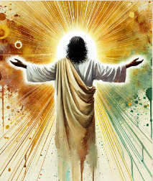
Lesson Six
Finding Our Joy in Christ:
“I Will Say It Again, Rejoice”
What are your worries?
  Pray; finding peace in difficult times – vv 6-7
  Focus on positive things – v 8
  Find contentment in every situation – v 12
  God / Christ is there to strengthen me – v 13
“Epistle of Joy”
  Paul wrote from prison to thank them
  Word “joy” & “rejoice” used 16 times in letter
  Repeating words or ideas show importance
  Look beyond difficulties, focus on bigger picture
Alternative Closing Prayer
  Close eyes & imagine sitting under waterfall
  Water = peace of God flowing throughout life
  Read 3 times Philippians 4:7
  End w/ “God’s peace be with you. Amen.”
Notes:
These are the things Paul is basically telling us in Philippians 4, which is Lesson 6.
A suggestion you might do before reading Philippians 4:1-23 is to ask the ladies in your group, “What are your worries?” It could be finances or children or a family member who is sick or numerous other things they list. Then, ask the ladies to look for ways Paul says in this passage can help them when they worry. There are probably many other things the ladies can point to, but I listed 4 things that jumped out at me. Verse 13 is the main theme of chapter 4 and one of the most quoted verses in Philippians – that Christ is there to strengthen us.
On page 64 our book tells how the word “rejoice” is used 9 times in this small, 4-chapter letter, but our author doesn’t really tell you why that is important, so let me give you a little more information about the “Epistle of Joy”.
Philippians is a book Paul wrote while he was a prisoner in Rome. Instead of correcting doctrinal matters as he did with other letters he wrote to churches, Paul wrote to say “thank you” to the church at Philippi for being so generous in supporting him over the years.
Our book tells us “rejoice” is used 9 times, but I count 11 times the word “rejoice” is used in the NRSVUE, which is the version of the Bible we are told our author used throughout the book. But the word “joy” is also used another 5 times in Philippians, which brings the total of joy / rejoice being used 16 times. That’s why it is often known as the “Epistle of Joy” because of Paul’s attitude in prison.
The authors of the Bible didn’t have adverbs like we do today to show an intensity of words. For instance, instead of saying someone was to be very joyful, you might say rejoice, rejoice. The same thing goes for an idea or theme in a chapter or a book. The more the word is repeated, the more important the idea is for that writing.
The theme of joy in the face of hardship teaches us a powerful lesson: true joy does not depend on our circumstances. Paul shows us we can find joy in our faith, no matter what we are going through. His words encourage us to look beyond our difficulties and focus on the bigger picture – our relationship with God and the hope we have in Him.
Alternative Closing Prayer: Have ladies close their eyes and imagine themselves under a cool, refreshing waterfall in a tropical paradise. Say: “The water is the peace of God flowing down into every area of your life, washing all worry and tension away.” Then, read Philippians 4:7 3 times, ending with, “God’s peace be with you. Amen.”

Slide 28
Finding our Identity in Jesus Christ
Openings about Finding Our Identity
https://youtu.be/SlfK482mFU4?feature=shared (1:39)
https://youtu.be/tCA-LM8_UeM?feature=shared (2:36)
https://youtu.be/dVFEM8W57tI?feature=shared (1:50)
  “God doesn’t have grandkids. You're either his child on your own, not riding the coattails of anybody else, or not.” – Priscilla Shirer
Notes:
One of the greatest challenges we have is maintaining our identity as Christians. The last 3 lessons of our study encourage us to root our identity in Christ rather than what the world says about you.
There are lots of videos to choose from, but I’ve listed on this slide 3 videos that you may want to use as an opening to the topic of “Finding Our Identity in Christ”. Also, you may want to use a different video for the opening for each of the last 3 lessons.
Openings about Finding Our Identity In Christ
The first one is from Andrew Marjoram that is an animated drawing of passages from the Bible that tell who you are as a Christian. - https://youtu.be/SlfK482mFU4?feature=shared
The second one is from the Cornerstone Church in Johannesburg, South Africa where a teenager takes you through an experiment that shows when we know the Identity that we have in Christ and that we are children of God then we will be secure and no matter what happens our identity will not change or be shaken. The teenager uses clear Orbeez water beads and water. https://youtu.be/tCA-LM8_UeM?feature=shared (2:36)
The third video is from author and speaker Priscilla Shirer from Dallas, Texas. https://youtu.be/dVFEM8W57tI?feature=shared (1:50)
I highlighted one statement she made in her video because I liked it – “God doesn’t have grandkids. You're either his child on your own, not riding the coattails of anybody else, or not.”

Slide 29
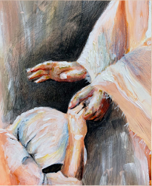
Lesson Seven
The Woman Who Was
Bent Over
Identity = Woman who was bent over
What else do we know about her?
  Woman
  Sickness kept her bound for 18 yrs
  Daughter of Abraham
  Believer in God
  Right with God
Discussion on questions of #3-#5, pp. 78-79
Video of story
  https://youtu.be/9pA_zkufafw?feature=shared (2:12)
  English Standard Version (ESV) of story
Notes:
Let’s look at Lesson 7. Even by the title of the lesson and what our author tells us on p. 72, we see that this woman is identified by the World by what she does NOT have – the ability to stand up straight, but to be bent over.
When you read the scripture, you might ask, “What else do we know about her?”
We do not know her name. But Jesus called her 'woman' in verse 12 when He called her to Him.
We do not know if she was married or had children. But we know that her sickness had kept her bound for 18 years. Luke, the physician, tells us that she was bent forward completely and unable to strengthen herself up or even look forward. All she could see were the feet of others moving as she stood or walked. It makes you wonder how she knew Jesus was calling her since she were only able to see others feet.
Later in verse 16, He said that she was a daughter of Abraham, which means she is a daughter of the covenant.
Though she was bent over, she was in the synagogue on the Sabbath, and when she was healed, she glorified God. That tells us she is a believer in God.
From these verses, I believe that her heart for God wasn't hindered by her affliction. Her physical body might be afflicted, but her heart was right where it should be. She was one who continued to seek after God. Therefore, she was right with God.
The “Suggestions for Leaders” includes some good questions that can be done in pairs, small groups or the entire group. The 3 items on pages 78-79 I would probably lean towards asking were numbers 3 through 5.
If you would like to listen to a video instead of having people read the passage, I’ve included a link to a video version of the story. They use the English Standard Version (ESV) of the story.

Slide 30
Lesson Seven
The Woman Who Was
Bent Over
Energy Stick
  To show how Jesus’ energy passed to woman
  Only works when we’re connected
  Steve Spangler Science Energy Stick
What We Can Learn from this Woman?
  Physically bent in body, not in Spirit
  Patiently faithful & believed in God’s power
  Responded positively to Jesus’ calling
  Never questioned miracle of Jesus Christ
  Had a thankful & rejoicing heart
Other Closing
  “Beautiful” by MercyMe
  https://youtu.be/bmUfJtsaqps (4:21)
Notes:
Something I have used with the kids in Sunday School to show them how Jesus heals people is an Energy Stick. Let’s see if we can demonstrate how this power of Jesus might have flowed to the woman using an energy stick. You can make a circle with the entire group or with 1 or 2 people. As the leader, you take hold of the energy stick by the silver end, and the last woman in the circle does the same. What happens? The sound goes off and the lights come on.
The power conductor sends a small current that goes through each person, completing the circuit and turning on the lights and the sound. The funny thing about this is that you feel nothing and see nothing. In the same way the energy stick only works when we are connected, Jesus’ healing energy only works when we are connected to Him.
If you click on this link labeled “Steve Spangler Science Energy Stick”, it will take you to the Amazon site where I bought my energy stick for $11.53.
CLICK Every healing story of Jesus in the bible is unique and comes with its own peculiar lessons. So, ask the ladies, “What can we learn from the woman who was bent over in the Bible?” I’ve listed 5 things as an example.
Physically bent in the body but not bent in the Spirit
Patiently had faith and believed in the power of God
Responded positively to Jesus’ calling in her life
Never questioned the miracle of Jesus Christ
Had a thankful and rejoicing heart
The suggestion on page 79 for gathering together with cellphone flashlights shining or candles or light sticks are all good suggestions as you read the closing prayer and/or sing the song “This Little Light of Mine”. Another closing could be to play the video of a song by MercyMe entitled “Beautiful”, which I have a link to on the slide. https://youtu.be/bmUfJtsaqps

Slide 31
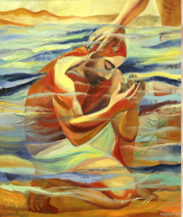
Lesson Eight
Remembering Jesus’ Baptism
Main Idea – We promise to…
  Live Christian faith
  Teach that faith to our children
  Turn from sin & its power in the world
  Be Christ’s faithful disciples
  Obey Christ’s word
  Show Christ’s love
Assign 4 groups a story from 4 gospels
Videos
  https://youtu.be/GgofETCbYns?feature=shared (2:55)
  https://youtu.be/Cxb8IMeXaxk?feature=shared (2:02)
You might not know about Jesus’ baptism
  Jesus was 30 & it marked beginning of ministry
  Jesus came from Nazareth – about 75 miles
  John where Ark / Joshua crossed Jordan River
Notes:
Every year I tell you my favorite lesson, and I think Lesson 8 is my favorite lesson for this year’s Bible study. It is “Remembering Jesus’ Baptism”. The author has included so many great points in this lesson that I thought I would go through and tell you some things I would highlight. Also, the “Suggestions for Leaders” has some different, inclusive ideas that will get everyone thinking about their own baptism. Of course, I have a few additional items that I will mention, too.
The main idea is more than what is listed at the beginning of Lesson 8. To me, the main idea is listed in the bottom left paragraph of page 82. “In baptism… (W)e promise to live the Christian faith, to teach that faith to our children, and to turn from the ways of sin and its power in the world. And we vow to be Christ’s faithful disciples, obeying Christ’s word, and showing his love.”
I like the suggestion on page 88 to divide your group into 4 small groups and assign each group a baptism story from one of the 4 gospels. Each group is to discuss the story among themselves then write one sentence expressing the meaning of baptism, which is to be read to the entire group.
I have also included links to 2 videos about the story of Jesus’ baptism.
I wanted to highlight a few things about Jesus’ baptism and baptism in general at this time.
The baptism of Jesus occurred when He was 30 years old and marked the beginning of His public ministry. According to ancient Jewish law and custom, 30 years was considered the age of full maturity, physically and mentally, and suitable for high degrees of responsibility.
Jesus was living in Nazareth (Mark 1:9) at the time, but he wanted to be baptized by his cousin John.
John was baptizing people at Bethany beyond the Jordan (John 1:28), which is the traditional place of the passage of the Ark and the nation under Joshua. That means Jesus would have walked about 75 miles to be baptized.

Slide 32
Lesson Eight
Remembering Jesus’ Baptism
Items I liked in lesson
  Top right paragraph, last 2 sentences on p. 82
  Bottom right paragraph on p. 82
  2nd to last right paragraph on p. 83
  Last left paragraph on p. 84
  3rd right paragraph on p. 84
  4th right paragraph on p. 84
  Middle right paragraph on p. 85
Think of an event told in all 4 Gospels
  11 events
  Only 3 events outside of Passion Week
  So few because each had different purpose
  Shows importance of baptism in Jesus’ life
The phases of life of a Christian – pp. 88-89
Notes:
Since there’s so many good things to highlight, I thought I would quickly list some of the main items that I liked that our author covered in this lesson. So, get your pens and pencils ready to underline or put a star or whatever you do to take note of a passage.
Top right paragraph on p. 82 – “Through baptism we enter the covenant God has established. Within this covenant God gives us new life, guards us from evil, and nurtures us in love.”
Bottom right paragraph on p. 82 – “… the baptism of Jesus was a sign to all… that he was the beloved child of God.”
2nd to last right paragraph on p. 83 – “A Christian’s answer to a crisis of identity is to remember who we are… and to reclaim whose we are... When we are lost, we can find and claim our identity in Christ.”
Last left paragraph on p. 84 – “So, another part of our identity is participating in Christian service. Ministry, volunteering, being a witness, and serving others are part of who we are as Christ’s children.”
3rd right paragraph on p. 84 – “The baptism of Jesus is found in all 4 gospels.”
4th right paragraph on p. 84 – “Prior to this, circumcision was the sign of the covenant. But with the coming of Christ, baptism and Holy Communion became sacraments…”
Middle right paragraph on p. 85 – “Jesus’ mission had to do not only with water but also with Spirit.
I want to go back to the 5th item I listed above – that Jesus’ baptism is found in all 4 gospels. Can you think of another event that is told in all 4 Gospels? I have listed the 11 events in all 4 Gospels on the Notes Page for this slide.
Baptism of Jesus: Mt. 3:1-17; Mk. 1:1-11; Lk. 3:1-22; Jn. 1:15-34
Feeding of 5000: Mt. 14:13-21; Mk. 6:30-44; Lk. 9:10-17; Jn. 6:1-15
Peter's Profession: Mt. 16:13-19; Mk. 8:27-29; Lk. 9:18-20; Jn. 6:66-71
Anointing by Mary: Mt. 26:6-13; Mk. 14:3-9; Lk. 7:36-50; Jn. 12:1-11
Triumphal Entry: Mt. 21:1-11; Mk. 11:1-10; Lk. 19:29-44; Jn. 12:12-19
Last Supper: Mt. 26:17-30; Mk. 14:12-26; Lk. 22:7-23; Jn. 13:1-35
Gethsemane: Mt. 26:36-56; Mk. 14:32-52 Lk. 22:40-53; Jn. 18:1
The Trials: Mt. 26:57-27:31; Mk. 14:43-15:20; Lk. 22:47-23:37; Jn. 18:2-19:3
The Crucifixion: Mt. 27:32-56; Mk. 15:21-41; Lk. 23:26-56; Jn. 19:1-37
His Burial: Mt. 27:57-28:15; Mk. 15:42-47; Lk. 23:50-56; Jn. 19:38-42
The Resurrection: Mt. 28:1-10; Mk. 16:1-11; Lk. 24:1-12; Jn. 20:1-18
Of these 11 events, only 3 of the events are outside of Passion Week – Jesus’ baptism, the Feeding of the 5000, and the Resurrection.
The baptism of Jesus marked the official beginning of His ministry. This is the time Jesus publicly showed His choice to follow God’s will.
Each of the Gospel writers had a different purpose in writing their Gospel.
Matthew was written to prove that Jesus was the Messiah, King of the Jews. Matthew focused on what Jesus said.
Mark was written to show Jesus as the Servant-Messiah. Mark focused on what Jesus did.
Luke focuses on an orderly account of events that show Jesus as the Son of Man. Therefore, Luke has much to say about what Jesus felt.
Finally, John presents Jesus as the Son of God who became a man. John emphasizes to who Jesus was.
Because each Gospel had a different purpose, that is why there are so few events that are repeated in all 4 of the Gospels.
To be told in all 4 Gospels shows how important this event of Jesus’ baptism was in Jesus’ life. Our baptism stands as a tangible sign to us of what God has done in Jesus. He has defined us as beloved children of God, filled with the Spirit in order to live new lives in Christ.
Turn to pp. 88 and 89 in your books. The idea included in the “Suggestions for Leaders” on pages 88 and 89 about the life of a Christian in 4 “phases” I thought was a great way to get everyone involved and thinking about specific experiences in their own lives. Joyce gives it 30 minutes for this exercise, which I think is about right. However, instead of just having the ladies “listen” for which group they would like to join, I would suggest posting it, typing up the information listed for the 4 groups, or pointing them to p. 88 so they can read along as you list each of the groups.

Slide 33
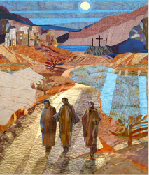
Lesson Nine
When You Are Walking With Jesus: The Road to Emmaus
2 Videos – reading of the Scripture
  https://youtu.be/A6f21Ekd7fE?feature=shared (2:21)
  https://youtu.be/QCWg4izAu2M?feature=shared (4:08)
Who were the travelers?
  Cleopas – Luke 24:18; Clopas – John 19:25
  Mary, wife of Clopas
  But, Luke 24:34 & 1 Cor. 15:4-6 implies it’s Simon
What / where about Emmaus?
  7 miles WNW from Jerusalem
  Common name, means “hot spring”
When did this happen? - Day of Resurrection
What happened while walking?
  Shows how all prophecies are true thru Jesus
  What they thought a failure was a success
Notes:
And finally, our last lesson on our identity section includes the story of 2 travelers encountering Jesus on the road to Emmaus. In case you do not want to read the passage from the Bible, I have included links to 2 videos that read the scripture while showing what is happening.
Do we know who the 2 travelers were that were on the road to Emmaus? Well, maybe.
From Luke 24:18 we know that one of the travelers was Cleopas, but the other traveler is a mystery. We have always been taught that it was another man, just as shown in the 2 videos which I included at the top of this slide. But there is speculation that it could have been a man and his wife, which is what the author of our study also mentions in the study book on p. 92.
If you check just about any concordance, you will find that there is a reference to John 19:25 for Luke 24:18. John 19:25 says, “Meanwhile, standing near the cross of Jesus were his mother, and his mother’s sister, Mary the wife of Clopas, and Mary Magdalene.” John spells the name a bit differently, but the spelling of names often varied in biblical times, especially when one author is writing in Greek and one author is writing in Aramaic, or old Hebrew. (Too bad they did not have Google to look up the spelling of every person’s name.) It is believed these 2 names refer to the same person. So, the wife of Clopas was also present in Jerusalem at the time of the Crucifixion, in fact at the foot of the cross. Therefore, it may have been Cleopas’ wife that was the one returning to Emmaus with him on the morning of the Resurrection.
However, the reason we have always been taught it was 2 men is because of 2 other verses. The first is at the end of this story, Luke 24:34 that says, “They were saying, ‘The Lord has risen indeed, and he has appeared to Simon!’” The second is 1 Corinthians 15:4-6 that says, “... and that he was buried and that he was raised on the third day in accordance with the scriptures and that he appeared to Cephas, then to the twelve. Then he appeared to more than five hundred brothers and sisters at one time, most of whom are still alive, though some have died.”
What do we know about Emmaus, and where is it located?
There is debate to the exact location, but it is believed it was located 7 miles west northwest of Jerusalem.
Emmaus was a common name for towns in the ancient world. The name means "hot spring," implying it may be that the village was known for its thermal springs.
When did this meeting with Jesus occur? The day of the Resurrection.
The 2 travelers seem to be part of the early group of followers of Jesus who were witnesses to all of the things that occurred that past week. They seem to be headed home to clear their heads after all of the events, including Jesus’ arrest, His crucifixion, and the report that He rose from the dead. Jesus appeared to these 2 people before He appeared to the 11 Apostles.
What happened?
Beginning with Moses and all the prophets, Jesus shows them how all of these prophecies have come true through Him. What they were thinking was a failure was really a success. Jesus transitions them from despair to faith.

Slide 34
Lesson Nine
When You Are Walking With Jesus: The Road to Emmaus
Why didn’t they recognize Jesus?
Jesus waited to be invited in
Importance of breaking of bread
  Beginning of Eucharist practice
  Symbolizes unity and remembrance of Christ
Would you walk 7 miles back?
  Even though late, they returned to tell others
  Would you have gone back immediately?
“Consider” in Suggestions for Leaders
Finding Our Identity in Jesus Christ
  What’s “go to” behavior In stressful states?
  What happens when our identity is lost?
  How do you find it again?
  Who are we if not Children of God?
  How do we find our anchor?
Notes:
The most asked question of this story is always, “Why didn’t they recognize Jesus until Him breaking the bread?” Luke tells how their eyes were kept from recognizing Jesus. By going through all of the Old Testament prophecies, perhaps Jesus is teaching the discouraged disciples a lesson on the miracle of His resurrection before revealing Himself to them and giving away all the answers. Perhaps this is a faith walk.
By the way, while Jesus was walking with the two disciples, it looked as if He was going to continue on. Jesus waited until they invited Him in, and then He became a crucial part of their lives. The same is true for us today. Jesus is never going to force Himself on us. He wants an invitation into our homes and into our hearts. And when that invitation happens, He opens our eyes to everything possible through Him.
The breaking of bread in Emmaus has significant implications for the practice of the Eucharist, which is Holy Communion, within Christianity. It was in Jesus’ action of breaking the bread that they recognized Him. It represents communion with Christ and the community of believers. This act of sharing a meal is central to many Christian traditions, symbolizing unity and remembrance of Christ’s sacrifice.
Immediately after Jesus vanished, the 2 disciples were so excited to share this wonderful news that they went back to Jerusalem to tell the other disciples they had seen Jesus. It was not an exorbitant amount of time. We are talking about probably a 2-hour, maybe 3-hour walk. But, would you have gone immediately back to tell the other disciples? Have you ever taken 2 hours to do something good for someone else or to share the gospel? Then, you can understand what these 2 disciples did.
In the “Suggestions for Leaders” for this lesson under the “Consider” section, Joyce lists several activities to explore. I would suggest splitting your group to do the first two 10-minute activities. Let them choose which activity they would like to do and discuss within their group. Let each small group share their thoughts with the entire group after the 10 minutes.
In the book at the top, right column on p. 94 and on the DVD, the author discusses finding our identity in Jesus Christ. She asks several questions on the DVD that might be good to ask of your group of ladies. The questions include:
What is your “go to” behavior in a stressful situation? Some begin to doubt the very existence of God. And our faith is not the only thing that is shattered. Our identity is lost.
When we lose our identity as a follower of Christ, how do we find it again?
Do we ignore this period of weak spirituality and hope our strong faith and sense of purpose will soon return?
Who are we if not Children of God?
Just like with the rubber band, how do we find our anchor? We might find that anchor and recognize Jesus when we offer hospitality to others and/or break bread together.

Slide 35
Lesson Nine
When You Are Walking With Jesus: The Road to Emmaus
End by showing one of “identity” videos
Lesson we can learn
  Recognize Christ in our lives
  Recognize the role of community
  Seek understanding through scripture
  Jesus meets us wherever you are
  Jesus waits for our invitation
  God calls us to have faith
  Never give up hope
  Share the good news
Notes:
I would probably end this lesson by playing one of the “identity” videos that I included at the beginning of this third part of the study to remind people about how they need to focus on their identity in Christ, not how others or “the world” identify us.
Through the lens of Emmaus, there are so many things we can learn. I’ve listed some of them here, but you and your group of ladies may come up with additional items. Some are: we are reminded of the importance of recognizing Christ in our lives and the role of community. Seek understanding through Scripture in nurturing our spiritual growth. Jesus will meet you right where you are, wherever you are. He waits for your invitation, because He loves you. Be encouraged and hold on to hope. And finally, share the good news with others.

Slide 36
Lord is My Rock
Psalm 18:2-3 (NIRV)
² The Lord is my rock and my place of safety. He is the God who saves me.
My God is my rock. I go to him for safety.
He is like a shield to me. He’s the power that saves me. He’s my place of safety.
³ I called out to the Lord. He is worthy of praise.
He saved me from my enemies.
Notes:
Finally, I would like to end with 2 things:
First, I have included a rock on the table for you that has “Psalm 18:2-3” written on the stone. I urge you to keep your stone handy to remind you how to handle your fears by being persistent and resilient, to remind you to choose to find joy and trust in God, and to remind you that you are a child of God who is loved and valued.
As we talked about before, when a word is repeated several times in a passage, then we know that idea is very important. So as I read this passage, I want you to notice how many times the words “save” and “safety” are used.
Psalm 18:2-3 (New International Reader's Version)
² The Lord is my rock and my place of safety. He is the God who saves me.
My God is my rock. I go to him for safety.
He is like a shield to me. He’s the power that saves me. He’s my place of safety.
³ I called out to the Lord. He is worthy of praise.
He saved me from my enemies.

Slide 37
Closing Prayer
Redeeming Christ, thank you for calling us by name and making us your own. When we forget that we are part of your family, help us to reclaim our identity, found in you. Open our eyes that we may recognize you. Open our hearts that we may serve you with joy. Guide us to participate in your reign in the world, for you pave the way for us to follow you. Amen.
Notes:
Second, let’s all of us read the Closing Prayer for Lesson 9 on p. 95, which is also shown on this slide.
Redeeming Christ, thank you for calling us by name and making us your own. When we forget that we are part of your family, help us to reclaim our identity, found in you. Open our eyes that we may recognize you. Open our hearts that we may serve you with joy. Guide us to participate in your reign in the world, for you pave the way for us to follow you. Amen.

Slide 38
Questions / Reflections
Notes:
Does anyone have any questions they would like to ask or reflections they would like to make?

